Slide 1

Department of Mechanical and Aerospace Engineering
High Powered Rocketry Club
2015-2016 PDR Presentation

Slide 2
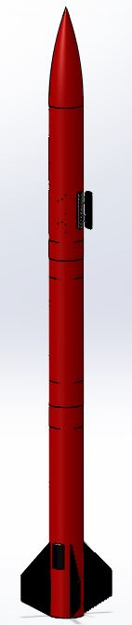
PDR Overview
  Vehicle
    Design
    Recovery
    Mission Performance
    Interfaces and Integration
  AGSE
    Design
    Arm
    Rocket Erection
    Igniter Insertion
  Budget
  Safety
  Subscale
  Questions

Slide 3
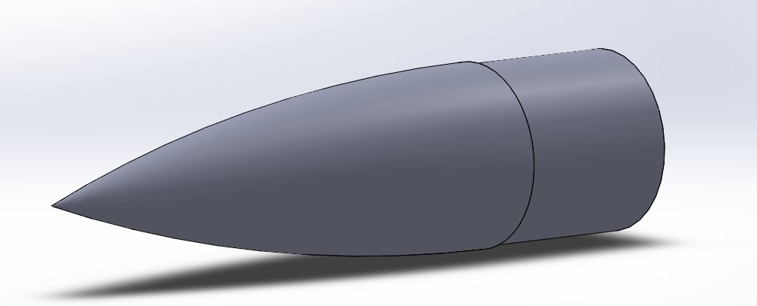
Vehicle Design - Nosecone
Element | Dimension
Maximum Diameter | 5.5 in
Exposed Length | 16 in
Shoulder Length | 5.0 in
Ogive shaped nosecone for higher subsonic drag

Slide 4
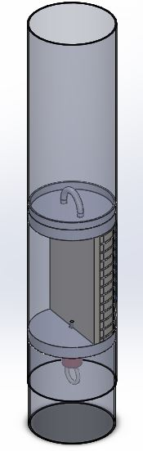
Vehicle Design - Airframe
5.5” diameter fiberglass tube
Body tube separated into four compartments sealed by bulkheads
Payload receptacle on forward airframe section

Slide 5

Rocket Layout
Payload Bay
1.5' Parachute
Airbrakes
Telemetry/Airbrake Control
4' Parachute
6' Parachute

Slide 6
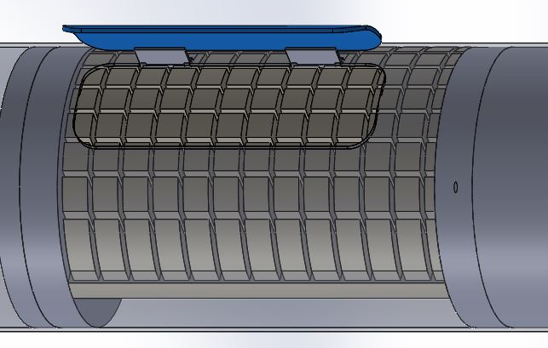
Airframe – Payload Zone

Slide 7
Vehicle Design - Avionics
Two avionics compartments
Primary and redundant altimeters
  Forward: Entacore AIM 3.0
  Aft: Statologger CF and SL100
9V batteries, 3D printed sled, GPS
Upper avionics: drogue charge 5280’, ARRD 1100’, nosecone from upper airframe 1000’
Aft sled middle and fin section 700’

Slide 8
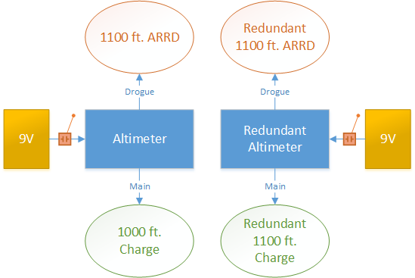
Forward Avionics

Slide 9
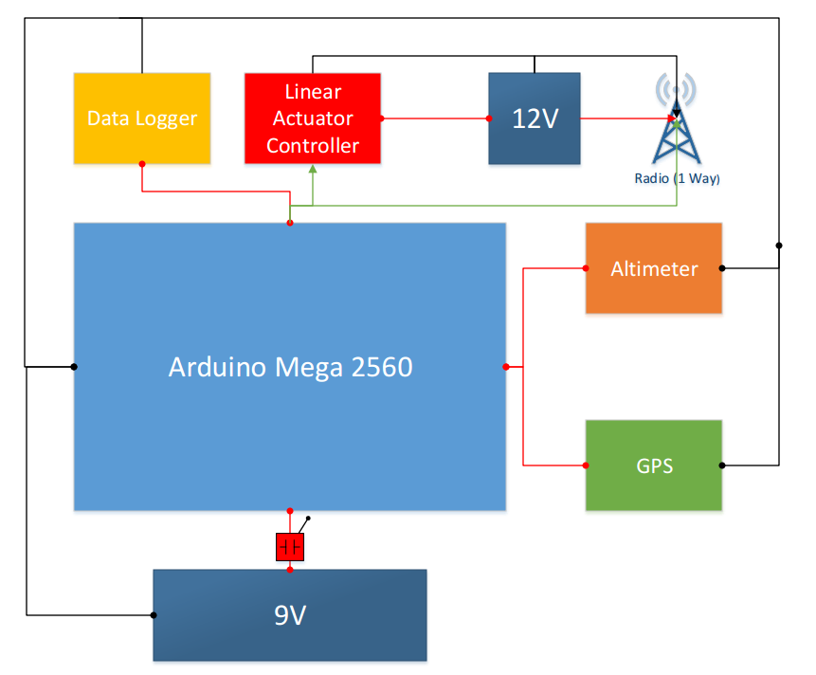
Aft Avionics

Slide 10
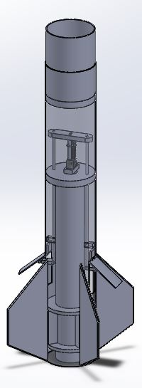
Vehicle Design – Fin Section
Element | Dimension
Length | 34.5 in
Diameter | 5.5
Element | Dimension
Width | 0.25 in
Height | 4.75in
Root chord | 12 in
Tip chord | 4.25 in
0.75” bulkhead will be epoxied 3” from the upper surface of the airframe
Centering rings on either side of fin tabs

Slide 11
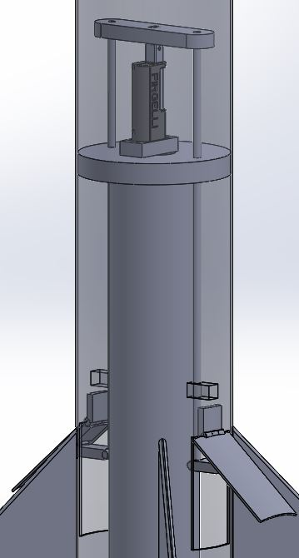
Vehicle Design – Airbrakes
Dual airbrake system
Airbrakes deployed with linear actuator
Deploy at 3000-4000 feet
Bring apogee to desirable level

Slide 12
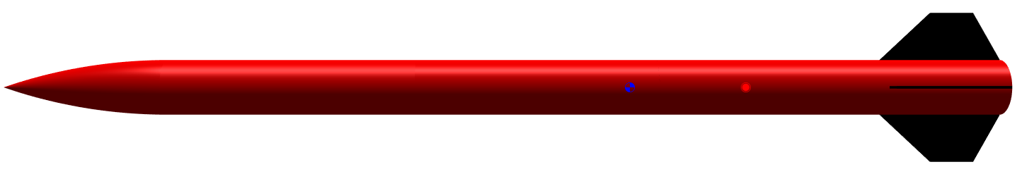
Vehicle Design - Stability
CG 63.0” nose ref.
CP 75.5” nose ref.
Static Margin 2.09
54 ft/s as the uppermost rail button leaves the launch rail
Center of Gravity
Center of Pressure

Slide 13
Vehicle Design - Motor
AeroTech L1150R
  20.87” Length
  0.295” Diameter
  258.5 lbf*s Impulse
  3.1 second Burn Time 1.68 lbs
  4.19 lb Propellant Mass
  Stability Margin increases from 2.09→3.21

Slide 14
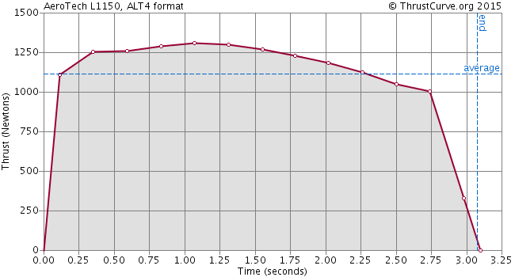
Thrust Curve

Slide 15
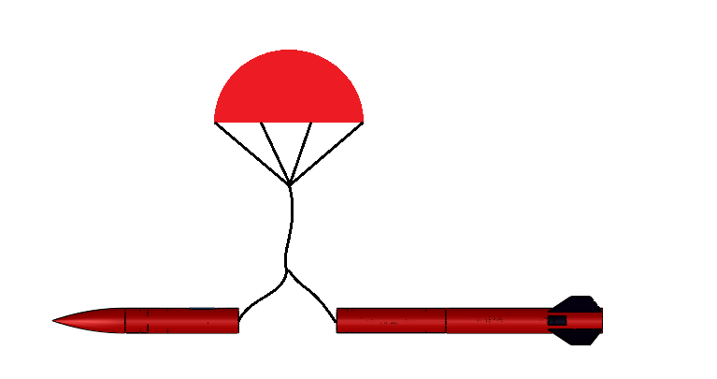
Vehicle Recovery
Apogee

Slide 16
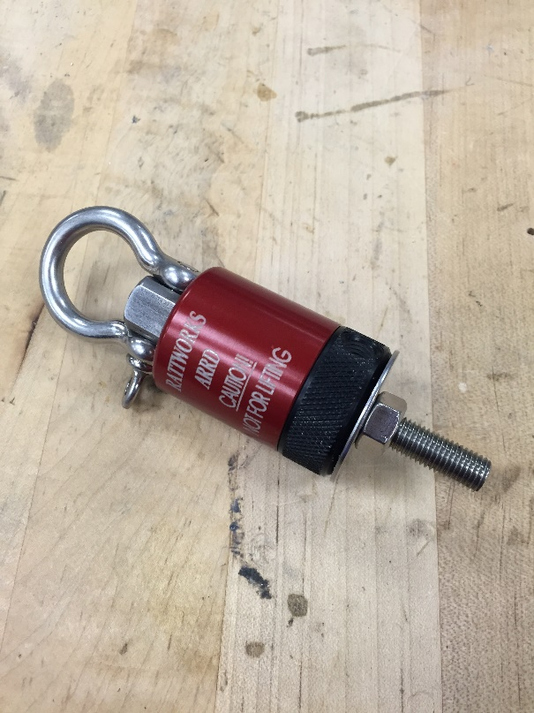
Vehicle Recovery: ARRD
ARRD uses black powder release
Separates drogue chute shock cord from upper airframe

Slide 17
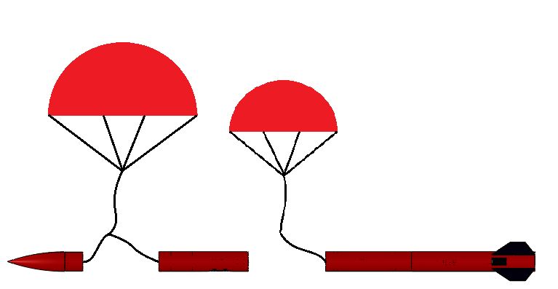
Vehicle Recovery
1000 ft

Slide 18
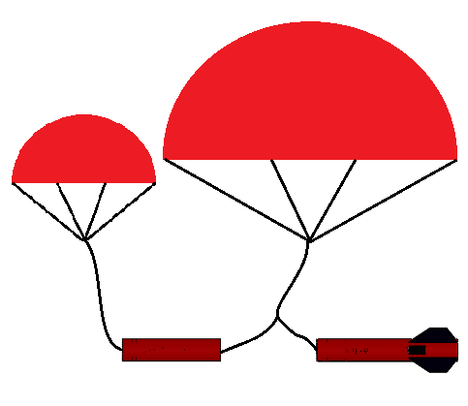
Vehicle Recovery
700 ft

Slide 19
Wind Drift
Wind (mph) | Forward Airframe(ft) | Fin Section (ft)
0 | 0 | 0
5 | 404 | 396
10 | 807 | 792
15 | 1211 | 1188
20 | 1614 | 1584

Slide 20
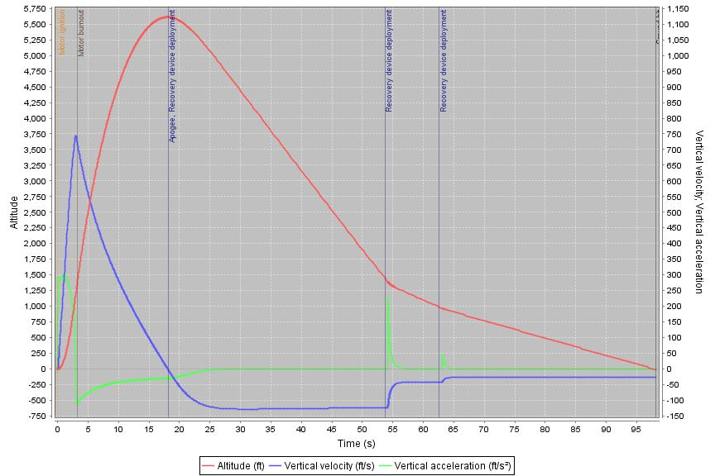
Mission Performance – Flight Profile
Open rocket simulation using AeroTech L1150R

Slide 21
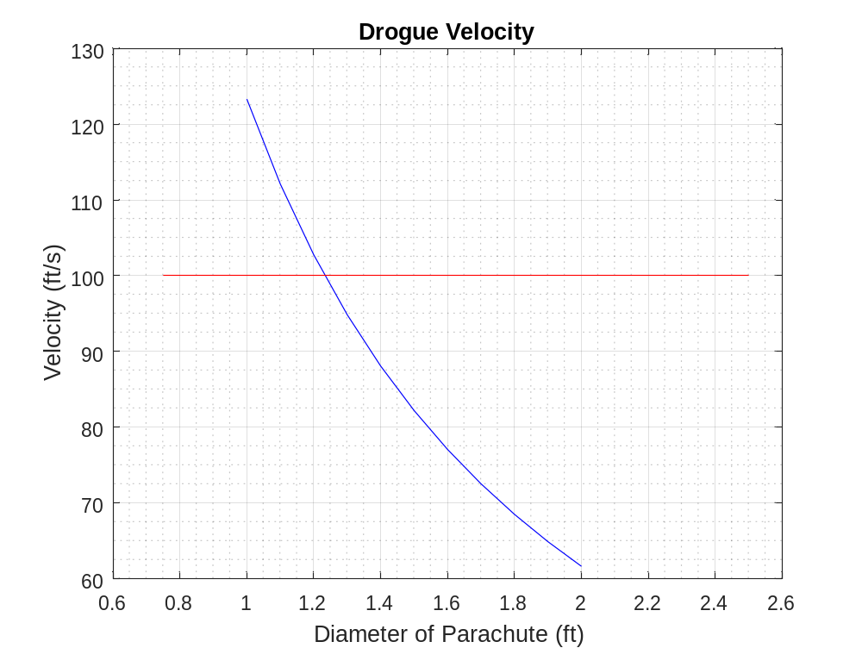
Mission Performance – Velocity

Slide 22
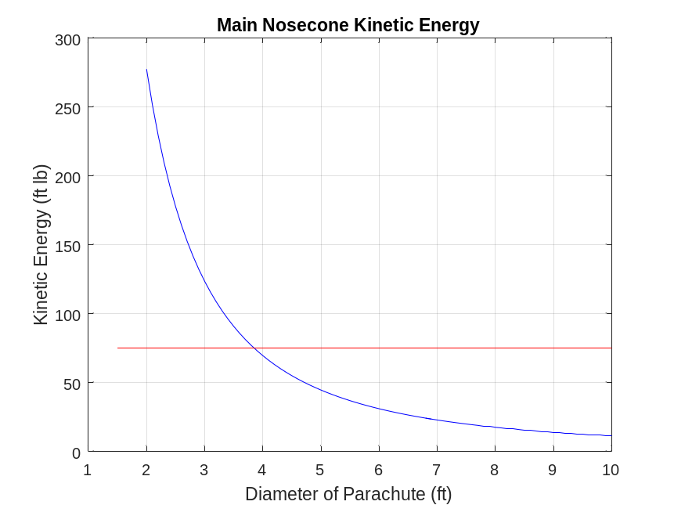
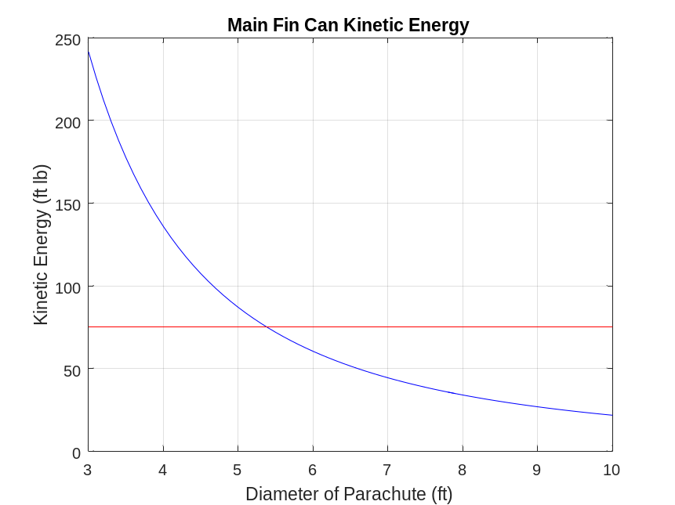
Mission Performance – Kinetic Energy

Slide 23
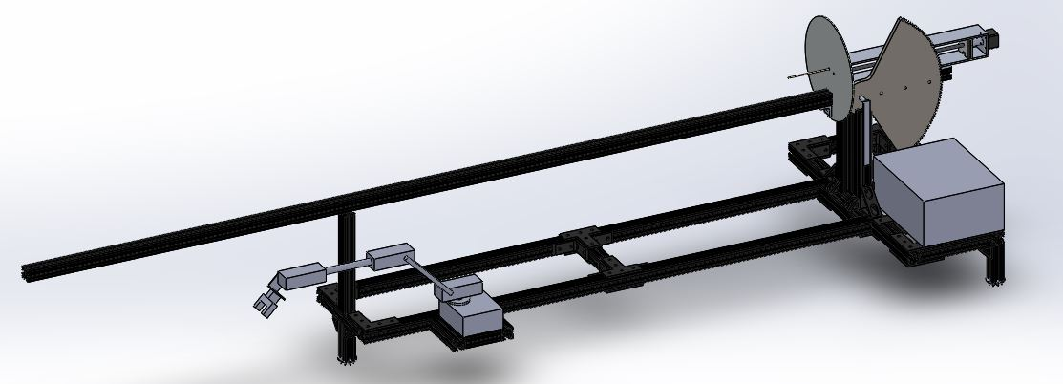
AGSE Design

Slide 24
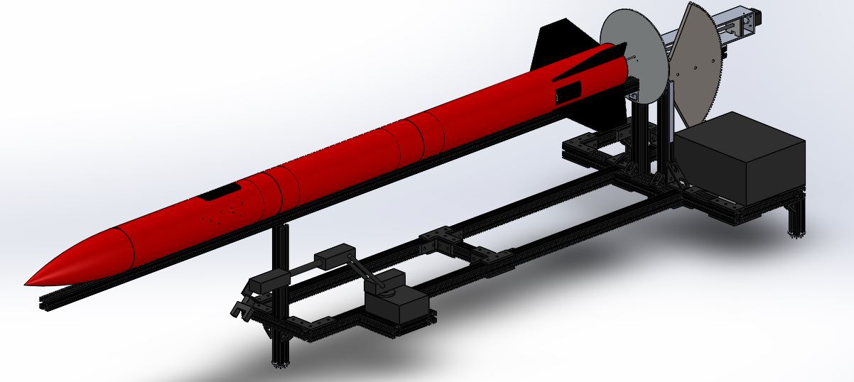
AGSE Design

Slide 25
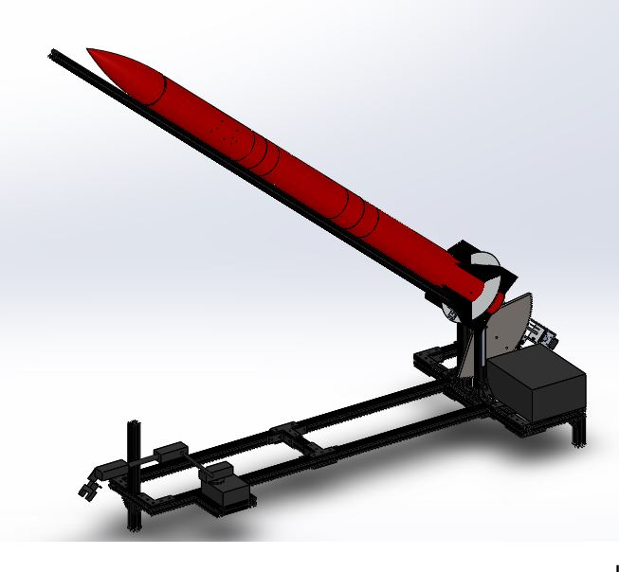
AGSE Design

Slide 26
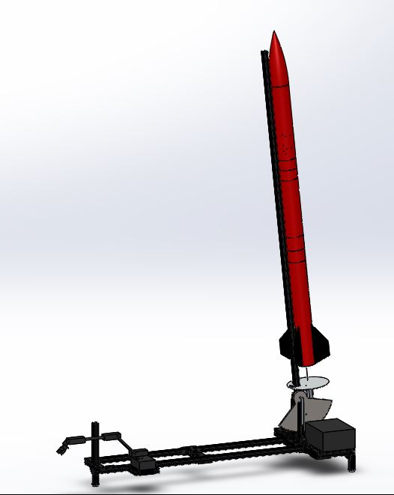
AGSE Design

Slide 27
AGSE Progression
Start System
Grab the Sample
Insert Sample in Foam
Raise the Rocket
Insert the Igniter
System Ready to Launch

Slide 28
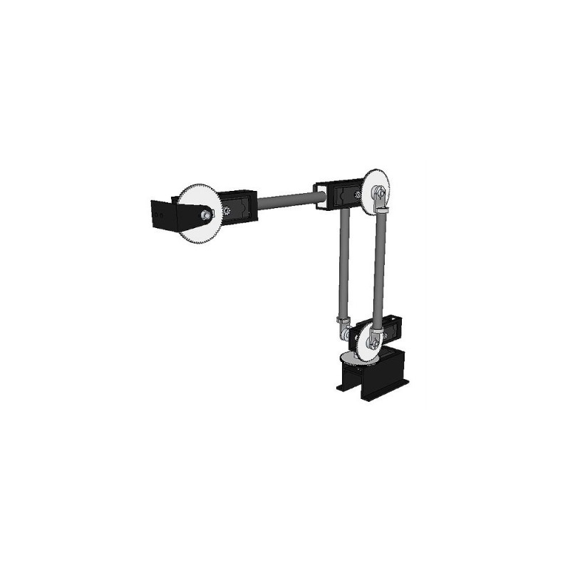
Robotic Arm
4 Degrees of Freedom
5:1 Gear Ratio
180 degrees of rotation at each joint
Able to lift ~1 lb at 24”
6V draw and current up to 10 A

Slide 29
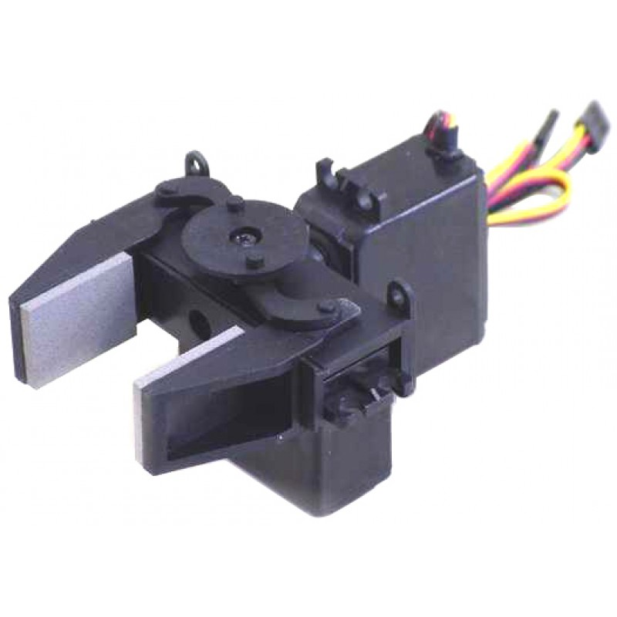
Gripper
Provides 2 additional DOF
180 degrees rotation around wrist
Able to open 1.3”
6V draw

Slide 30
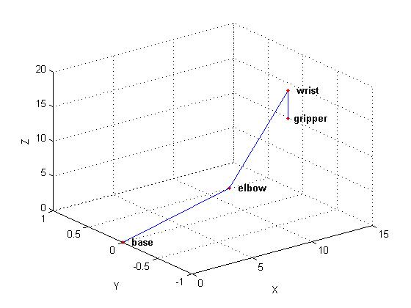
Model of Arm
MATLAB used to plot arm at different servo angles

Slide 31
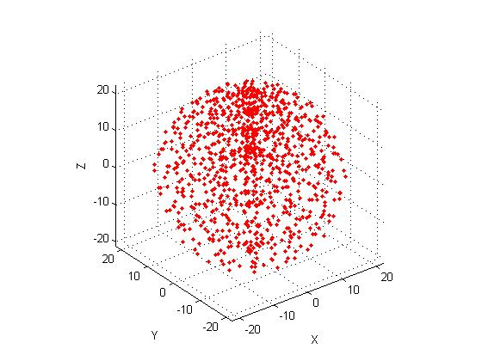
Reachable Points
MATLAB plot of all points the arm is able to reach in 3 dimensional space

Slide 32
AGSE Progression
Progression of the system will be time based, with each subsystem set to begin operating after a set period of time from the start

Slide 33
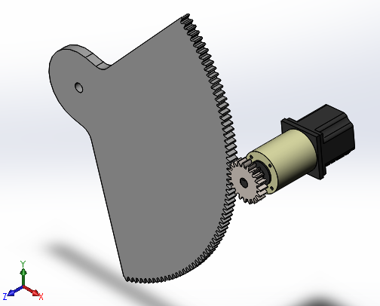
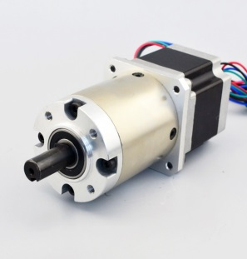
Raising the Rocket
Planetary Gearbox Stepper Motor
  Max Holding Torque: 29.5 ft-lb
  Step Angle: 0.039 deg
  ~22,000 steps for 85 deg launch rail rotation
Sector Gear
  Gear Ratio: 7.5:1
Required holding torque:
  18.69 ft-lb

Slide 34
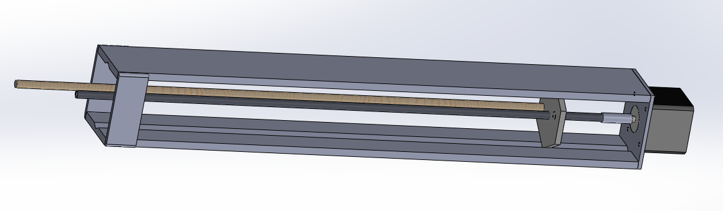
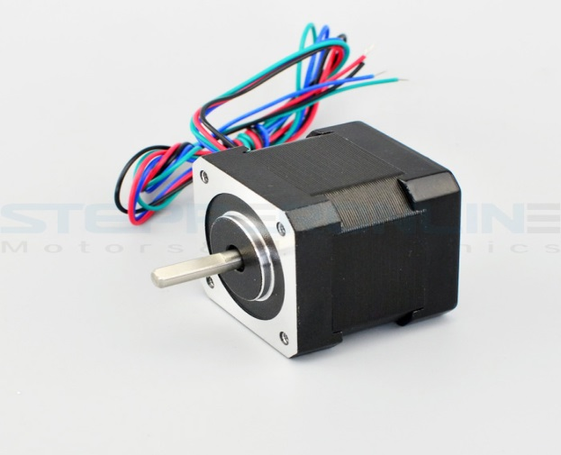
Igniter Insertion
Linear Actuator System
NEMA 17 Stepper Motor
Design Concept:
Stepper motor rotates threaded rod.
Threaded hexagonal plate moves vertically due to side plates.
Igniter on dowel moves upward into rocket motor.

Slide 35
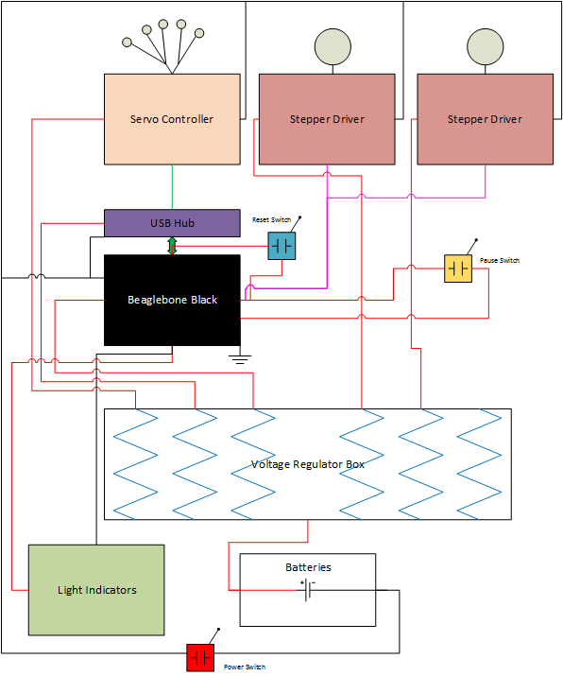
Electrical Schematic
Overview

Slide 36
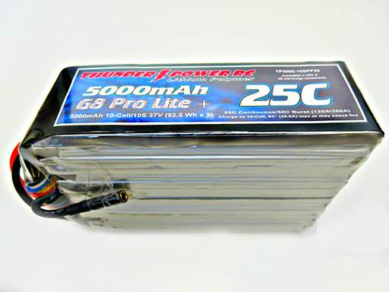
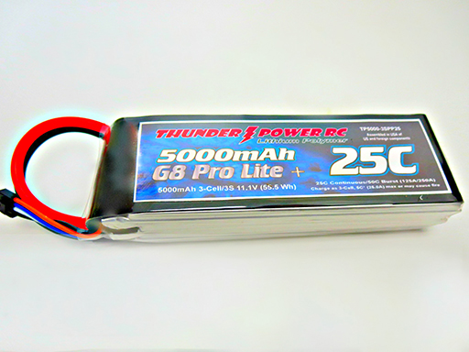
Battery Systems
37 V System
11.1 V System

Slide 37
37 V System
Used to power two stepper motors
  Raising Rocket
  Raising Igniter
Stepper motors require high power to meet torque requirements to raise the rocket
37 V System

Slide 38
11.1 V System
Step-Down voltage regulators to convert to the desired voltage of different electronics
Systems on this battery
  BeagleBone Black
  Robotic arm
  Robotic arm controller
  Rocket Stepper Motor Driver
  Igniter Stepper Motor Driver
11.1 V System

Slide 39
Subscale Demonstrator
Subscale is 70% of fullscale
Aerotech I284W Motor
Dual Deploy
18 in. Drogue
48 in. Parachute

Slide 40
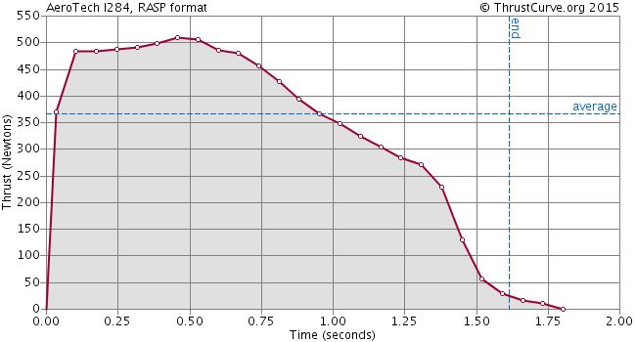
Subscale Motor Thrust Curve
Aerotech I284W

Slide 41
Community Outreach
Tripoli Summer Low-Mid Power Launches
STEM Career Fair for Students with Disabilities
Thales Academy Rocket Unit Kick-Off
YMCA Kite and Rocket Day
Sigma Gamma Tau Boy Scout Merit Badge Event

Slide 42
Thank You
QUESTIONS?

