Slide 1

Department of Mechanical and Aerospace Engineering
NC State University High Powered Rocketry Club
2014-2015 Flight Readiness Review

Slide 2
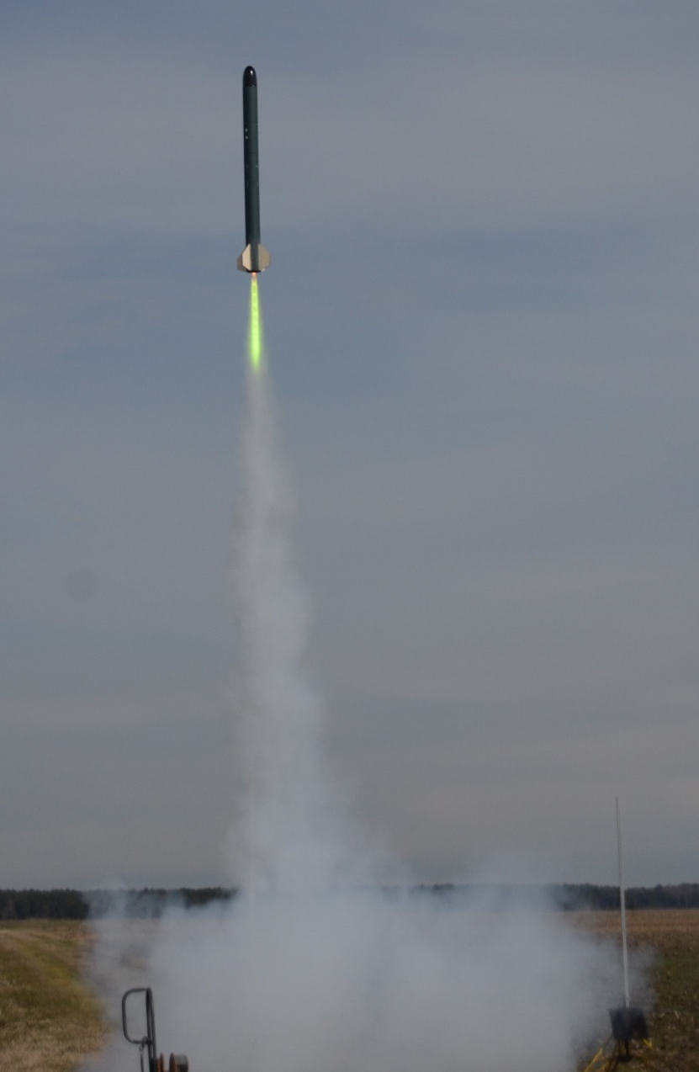
FRR Overview
Launch Vehicle
  Layout
  Recovery
  Performance
Full Scale Launch
  Predictions
  Results
AGSE Design
  Platform Dimensions
  Construction
AGSE Subsystems
  Robotic Arm and Imaging
  Rocket Raising System
  Igniter Inserter
Requirements Verification
Conclusion

Slide 3
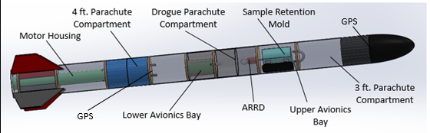
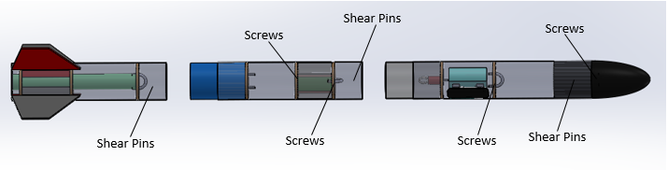
Vehicle Design - Layout

Slide 4
Vehicle Design - Weight
Component | Pounds | Ounces
Nosecone | 1 | 1-1/8
Upper and Mid Section (Empty) | 3 | 13
Fin Section | 4 | 8-5/8
Motor | 3 | 6-2/5
Parachutes | 1 | 3-1/8
Shock Cord and Recovery Hardware | 1 | 7
Avionics Hardware | 4 | 4-3/4
General Hardware | 0 | 13-3/8
Total | 19 | 14-2/5

Slide 5
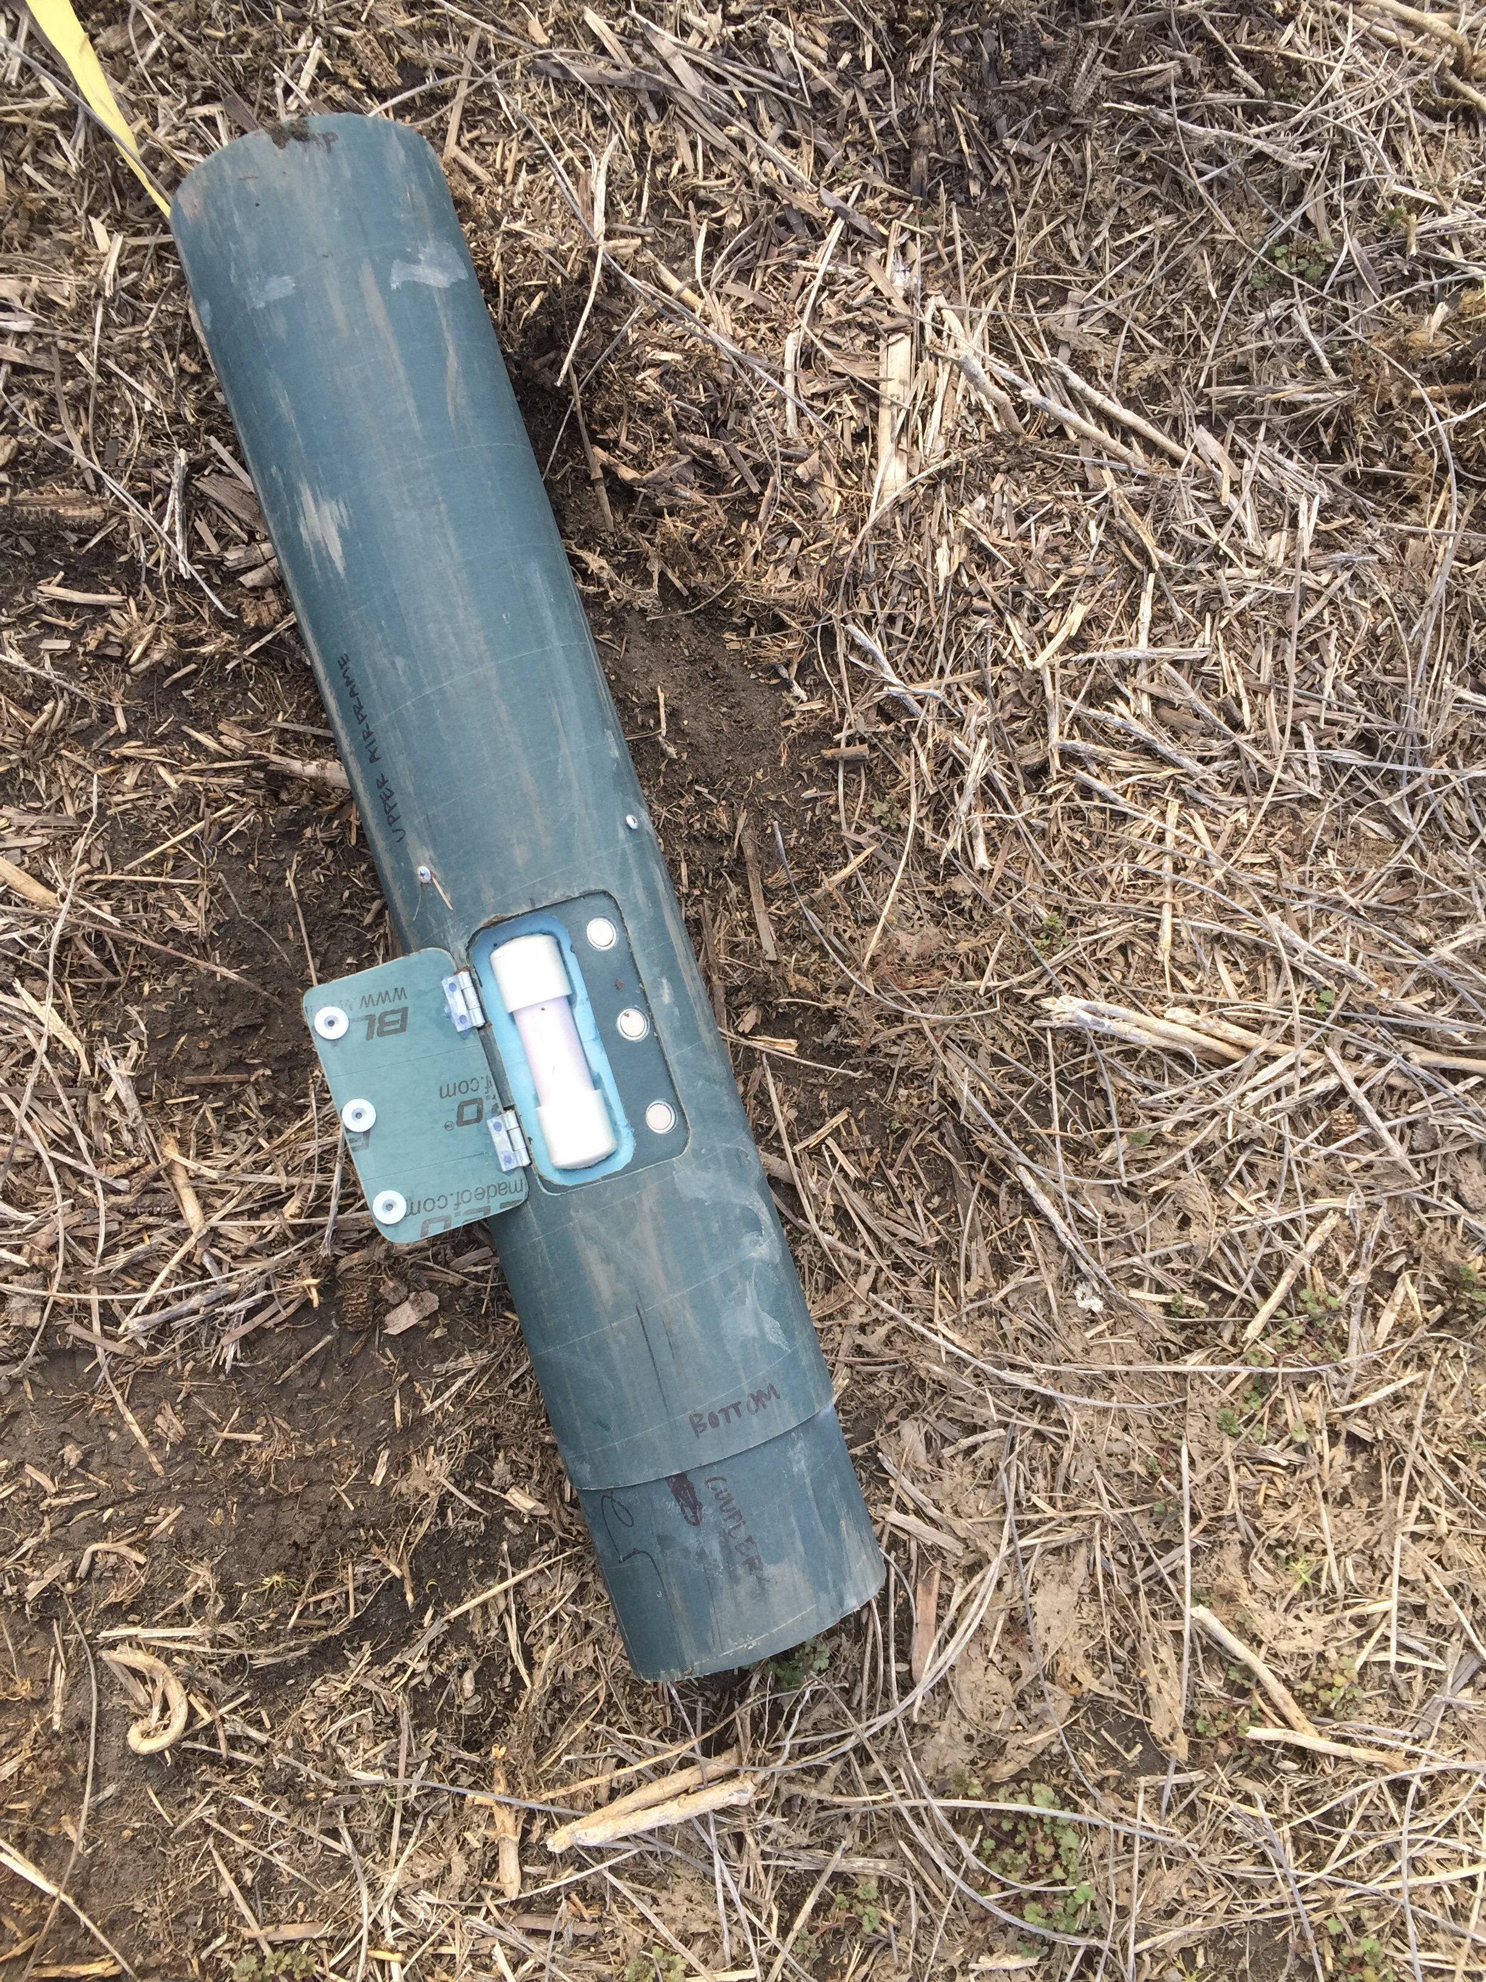
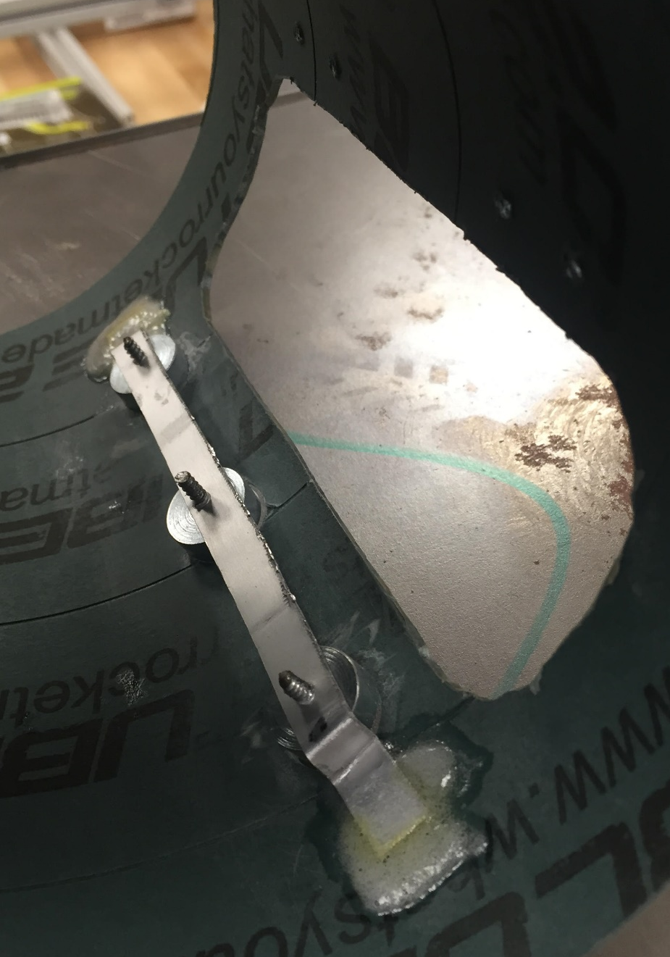
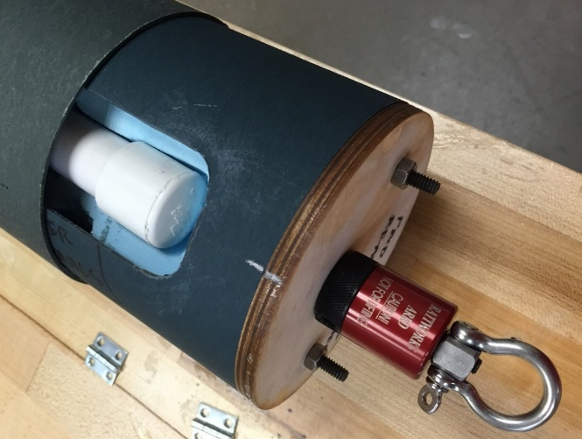
Payload Integration

Slide 6
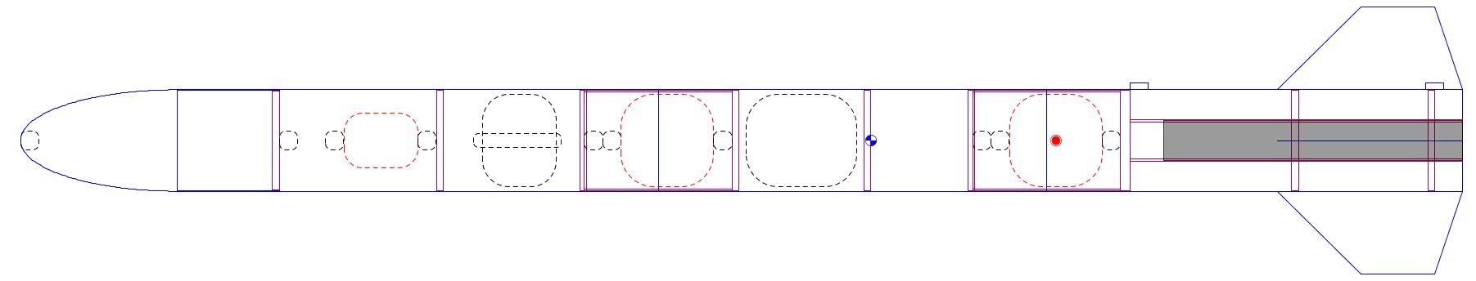
Flight Stability
Center of Gravity
Center of Pressure
Center of Pressure (inches from nose): 56.0
Center of Gravity (inches from nose): 46.5
Static Stability Margin: 1.7–
Verified using OpenRocket, Barrowman’s Equations, and Fluent CFD which were +-0.1 from actual

Slide 7
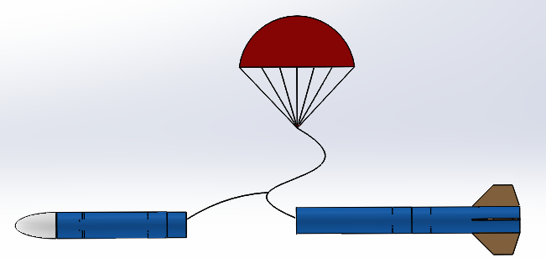
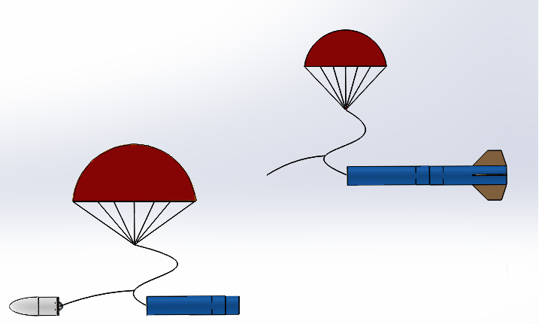
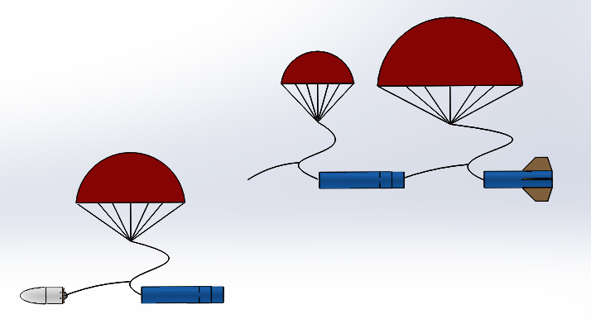
Vehicle Recovery– Event Sequence
18” Drogue Parachute
Apogee
36” Main Parachute
1000 ft
700 ft
48” Main Parachute
Notes:
1.5 foot drogue parachute deploys at apogee

Slide 8
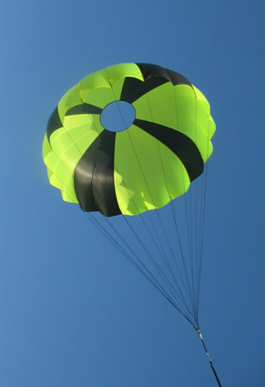
Vehicle Recovery - Parachutes
72 feet per second on the drogue parachute, slowing the entire rocket after apogee
57 feet per second for the drogue, slowing only the lower airframe
22 feet per second for the 36” main, slowing the nosecone and upper airframe section
19 feet per second for the 48” and drogue, slowing the middle airframe section and fin section

Slide 9
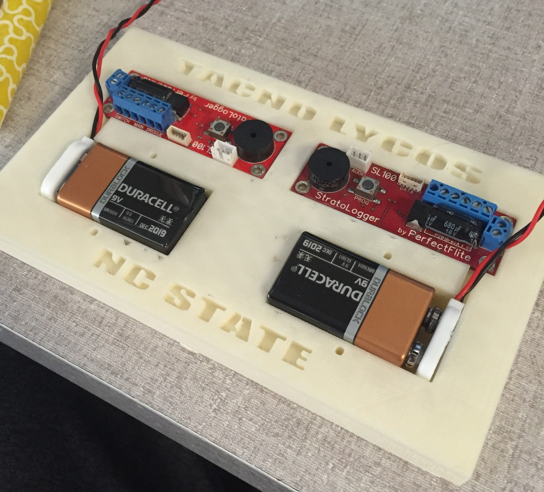
Vehicle Recovery - Avionics
Two avionics compartments:
  Stratologger SL100, Stratologger CF, two Entacore AIM 3.0 altimeters, 9V batteries, 3D printed ABS sled, and GPS
  Upper avionics: Drogue charge apogee +1 second, ARRD 1100’, nosecone from upper airframe 1000’
  Lower avionics: Middle and fin section at 700’
Notes:
How the avionics will work with recovery system

Slide 10
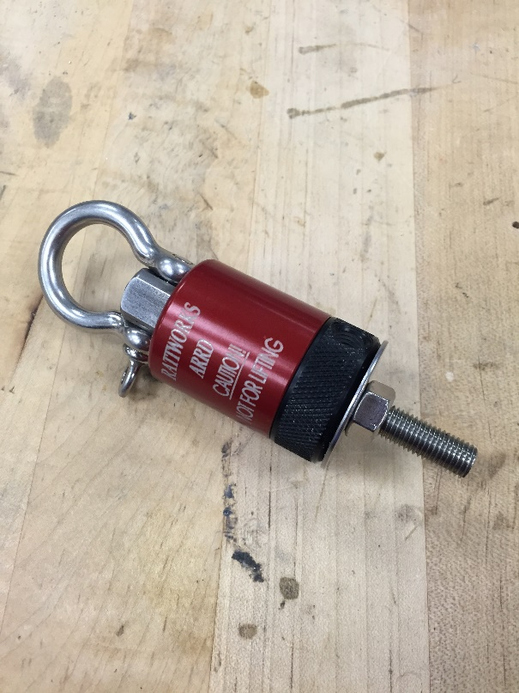
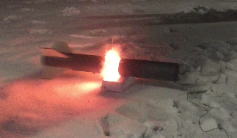
Vehicle Recovery System - Tests
ARRD performance tests
  Complete release of eye-bolt on all tests
  Successful at 0.1 grams black powder
Ejection Tests
  Drogue Chute 1.2g charge
  Main Chute 2.0g charge in nose
  Main Chute 1.2g charge in fin section

Slide 11
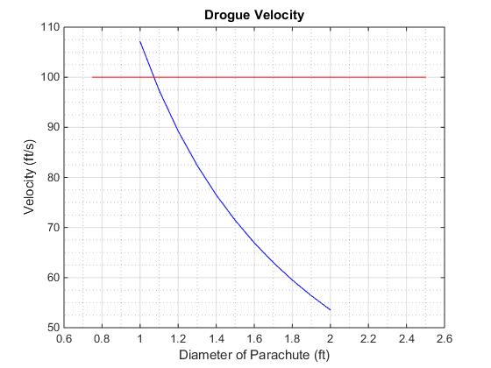
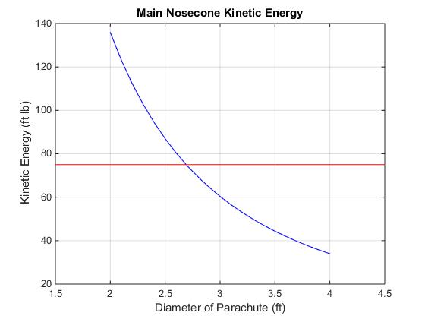
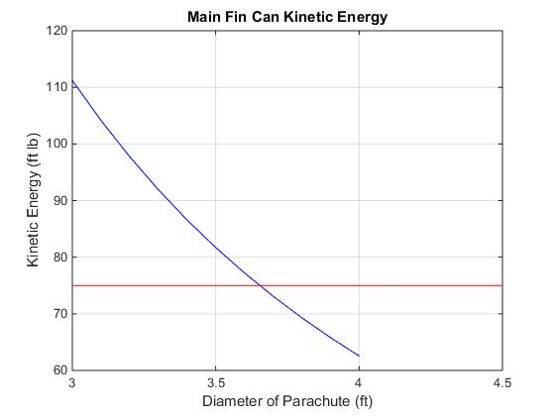
Mission Performance – Kinetic Energy
Vehicle Under Drogue Velocity
Main Nosecone Kinetic Energy
Main Fin Section Kinetic Energy
Notes:
Under drogue we wanted to keep the whole rocket under 100 ft/s
Chose 1.5 foot drogue –keeps velocity under 75 ft/s to be on the safe side of the margin

Slide 12
Vehicle Recovery - Wind Drift
Lateral Drift Due to Wind, 5° Launch Angle Into the Wind
Wind Speed (Miles per Hour) | Distance From Launch Site (Upper Airframe) | Distance From Launch Site (Lower Airframe)
0 | 641 | 640
5 | 79 | 78
10 | 698 | 695
15 | 1317 | 1313
20 | 1936 | 1930
Lateral Drift Due to Wind, 5° Launch Angle with the Wind
Wind Speed (Miles per Hour) | Distance From Launch Site (Upper Airframe) | Distance From Launch Site (Lower Airframe)
0 | 641 | 640
5 | 1159 | 1158
10 | 1778 | 1775
15 | 2397 | 2393
20 | 3016 | 3010
Notes:
Wind drift calculations. First number is for the payload section ---has the longest drift values
Second value in parenthesis is for shorter distance ---the fin section
Maximum expected distance with 20 mph winds is less than ½ mile

Slide 13
Vehicle Performance - Wind
Altitude Variance Due to Wind, 5° Launch Angle
Wind Speed (Miles per Hour) | Apogee of Rocket(feet)
0 | 3220
5 | 3205
10 | 3150
15 | 3100
20 | 3055

Slide 14
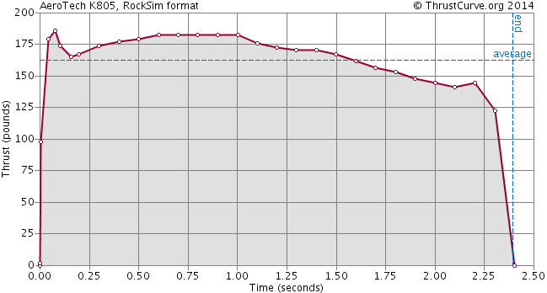
Vehicle Design – Motor Selection
AeroTech K805G
Weight: 3.40 pounds
Length: 15.8 inches
Maximum: 181 pounds
Total impulse: 396 lb-s
Burn time: 2.2 seconds
Thrust-to-weight ratio: 9:1

Slide 15
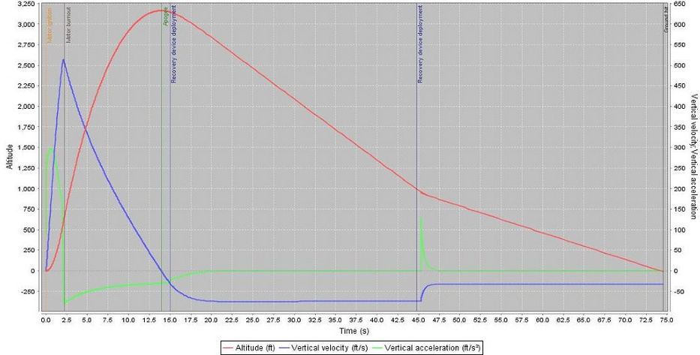
Vehicle Performance– Flight Profile
OpenRocket Simulation using AeroTech K805G

Slide 16
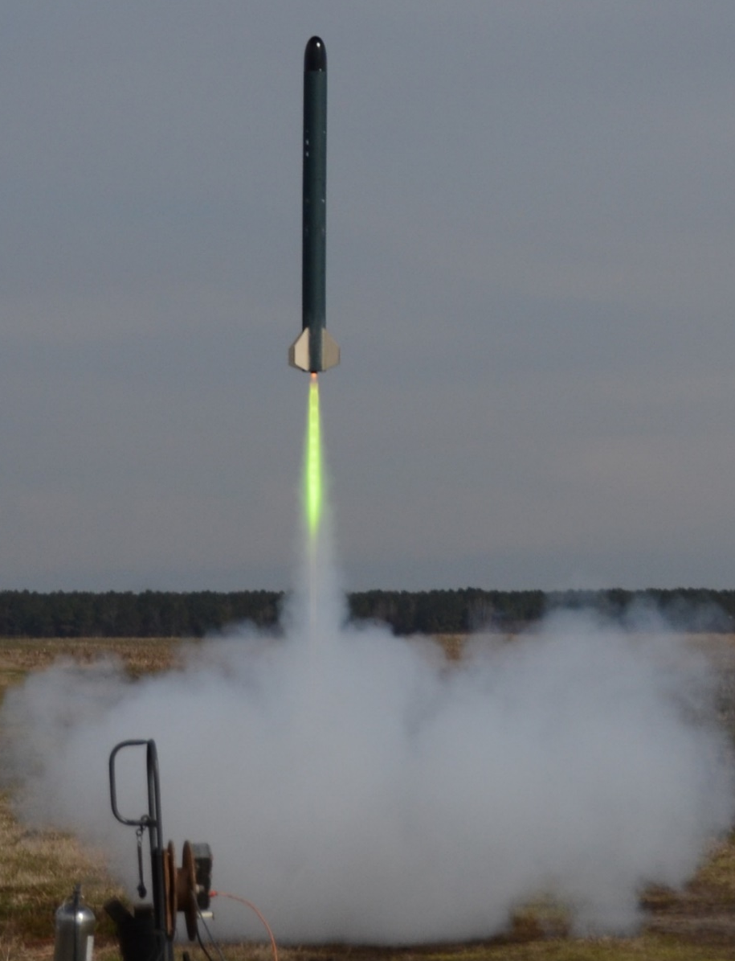
Full Scale Launch

Slide 17
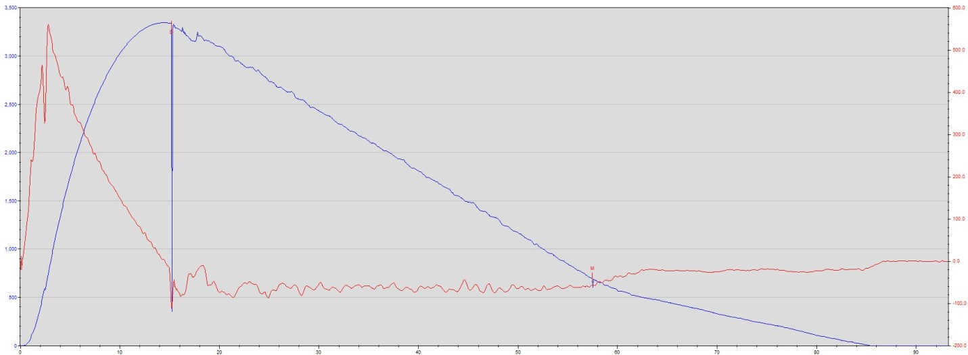
Stratologger CF Data
Apogee: 3345 ft
Time: 85.2 sec
Max Velocity: 560 ft/s
Apogee Delay: 1 sec
Main Chute Deployment: 700 ft

Slide 18
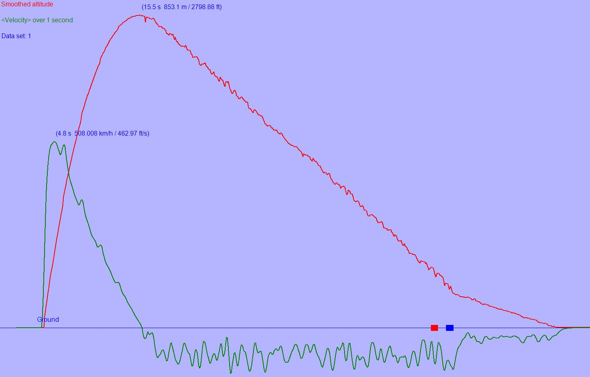
Entacore Data
Entacore AIM 3.0 Data

Slide 19
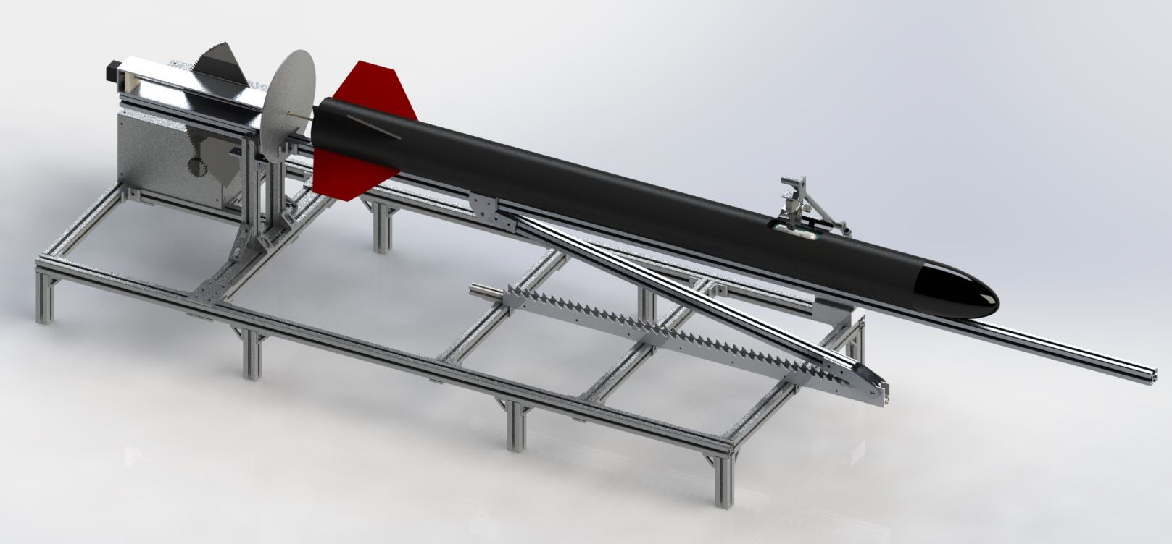
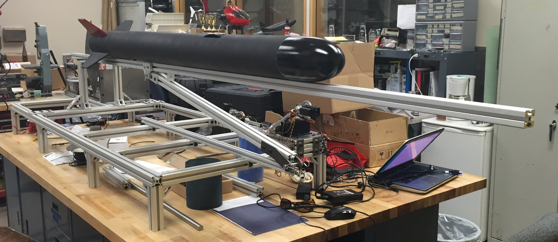
AGSE DESIGN

Slide 20
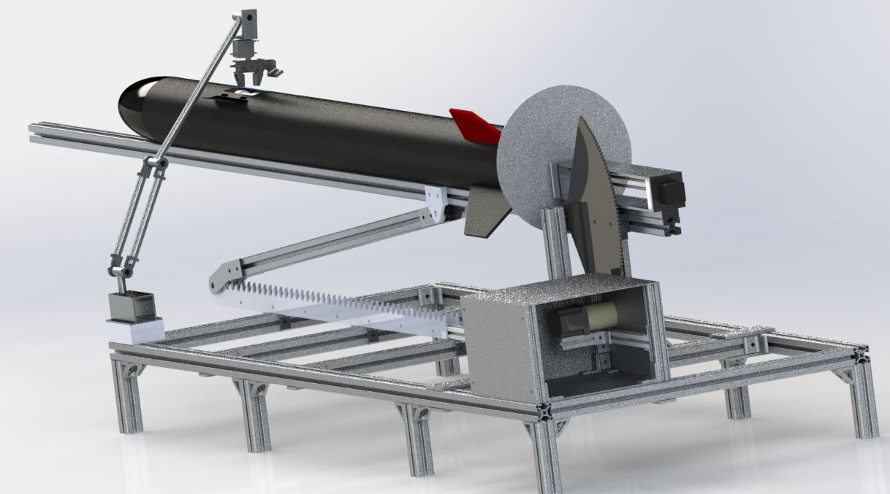
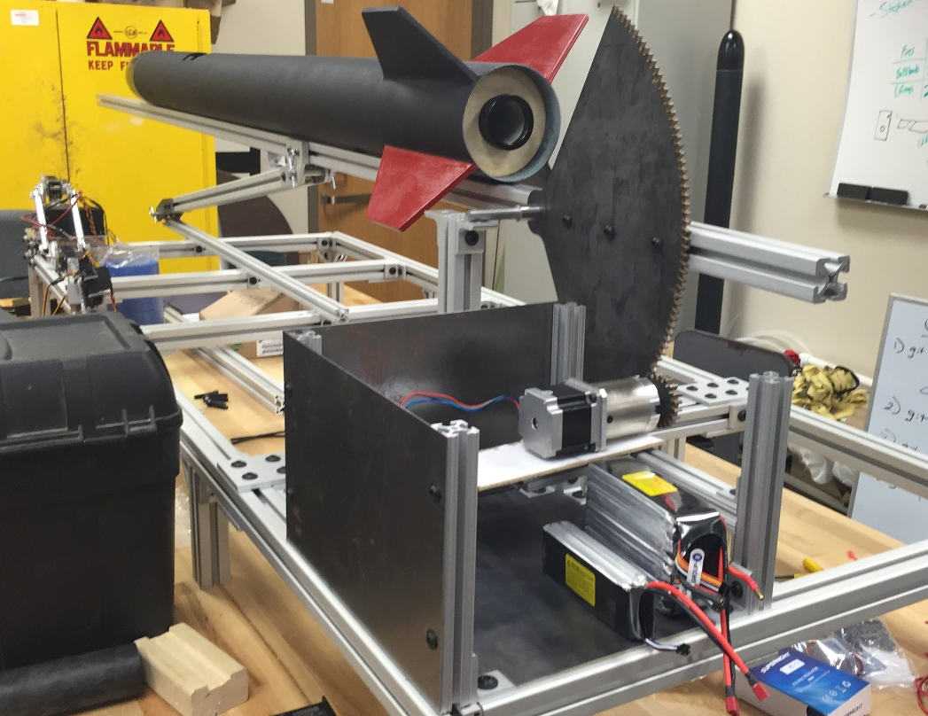
AGSE DESIGN

Slide 21
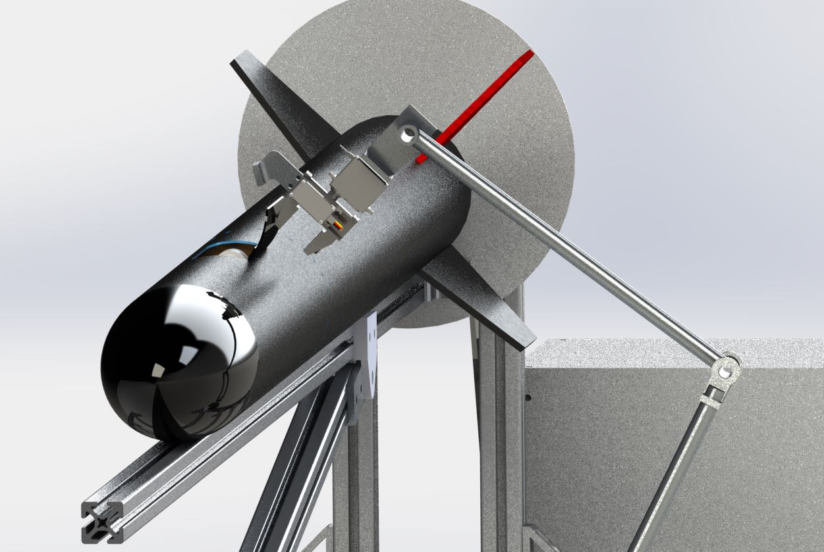
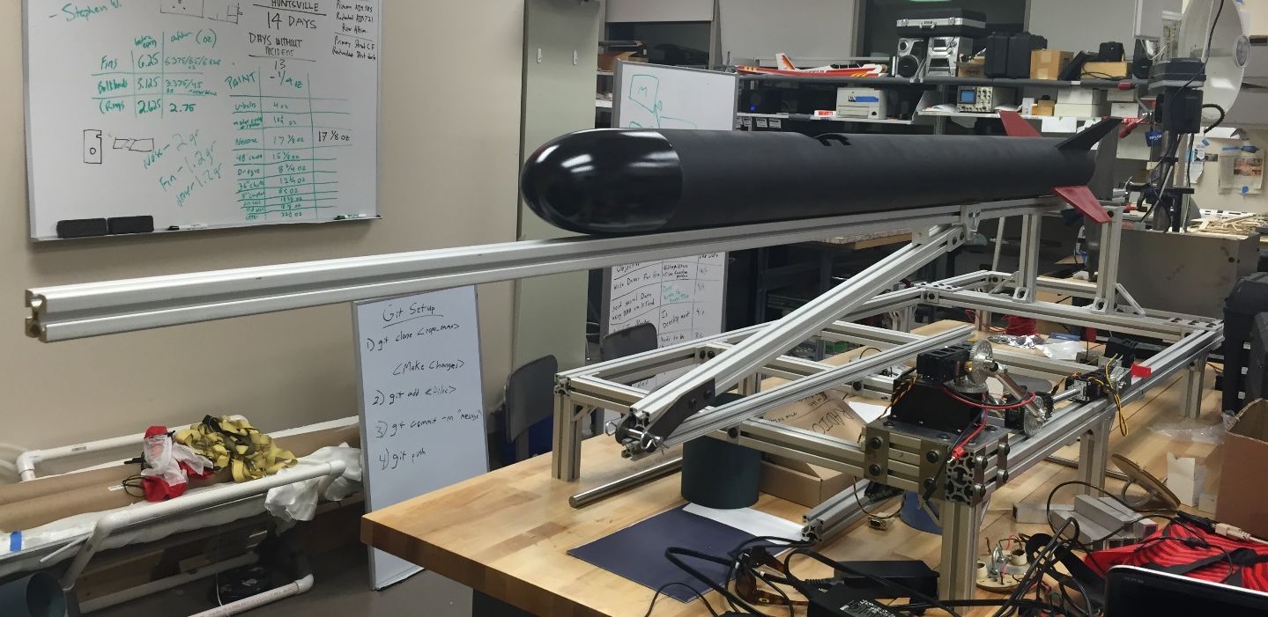
AGSE DESIGN

Slide 22
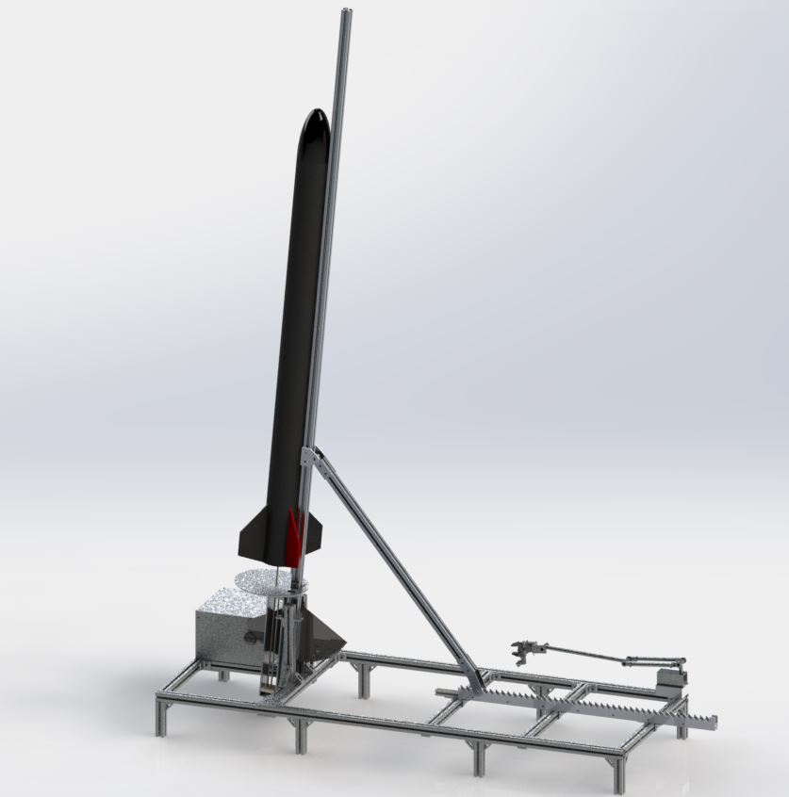
AGSE DESIGN

Slide 23
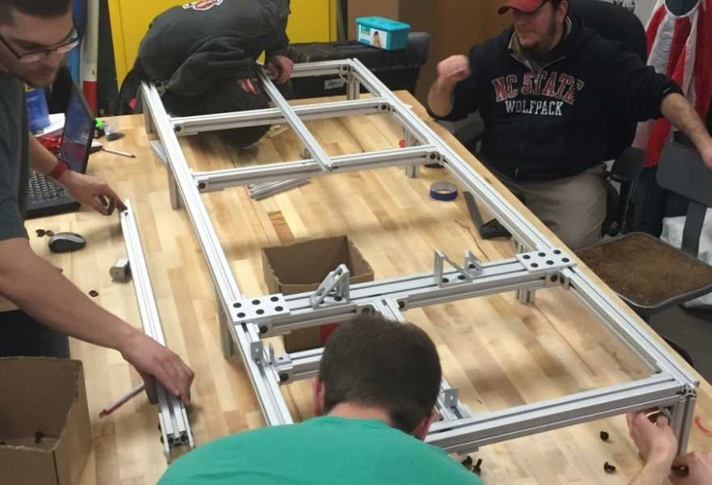
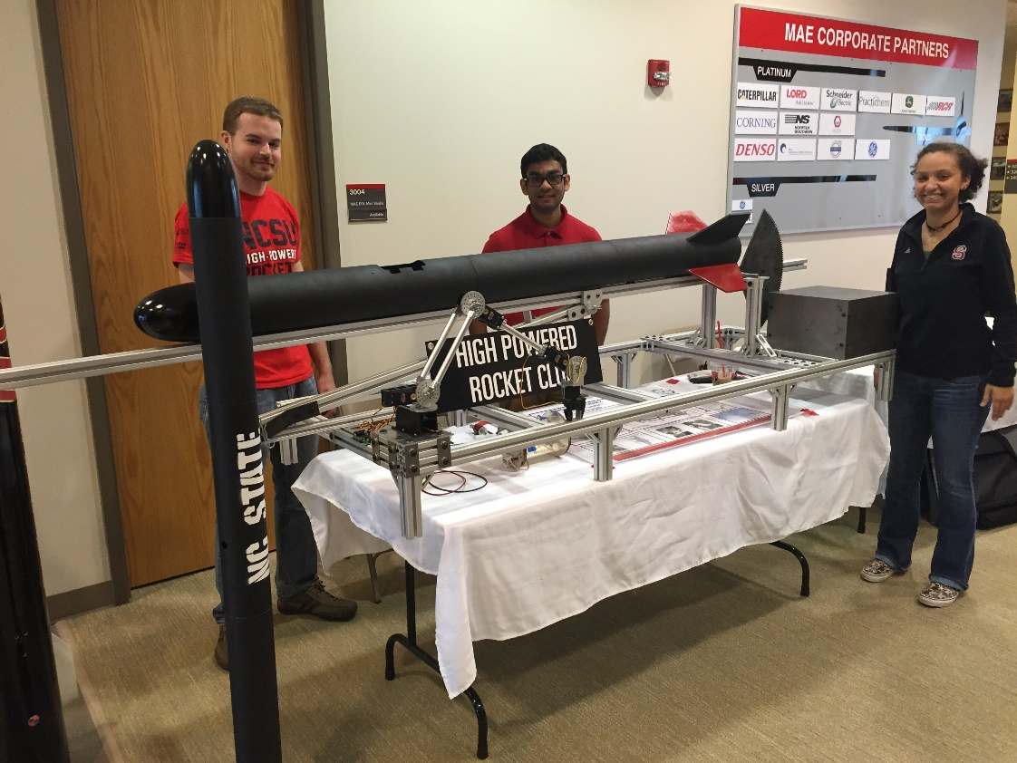
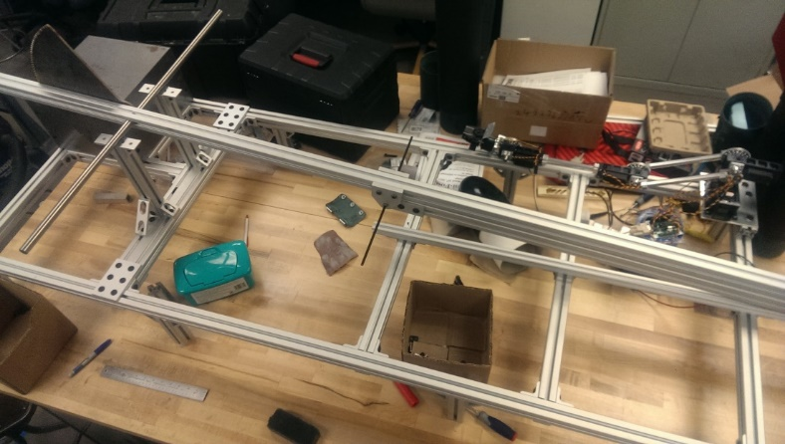
AGSE Construction

Slide 24
AGSE - Progression
Start System
Grab the Sample
Insert Sample into Mold
Raise the Rocket
Insert the Igniter
System Ready to Launch

Slide 25
Interfaces
AGSE and Launch Vehicle
      Kill and pause switches on AGSE
      Indicator LED on AGSE
      Altimeter switches on Launch Vehicle
Ground Station
      AGSE Monitor
      BRB900 GPS Tracker

Slide 26
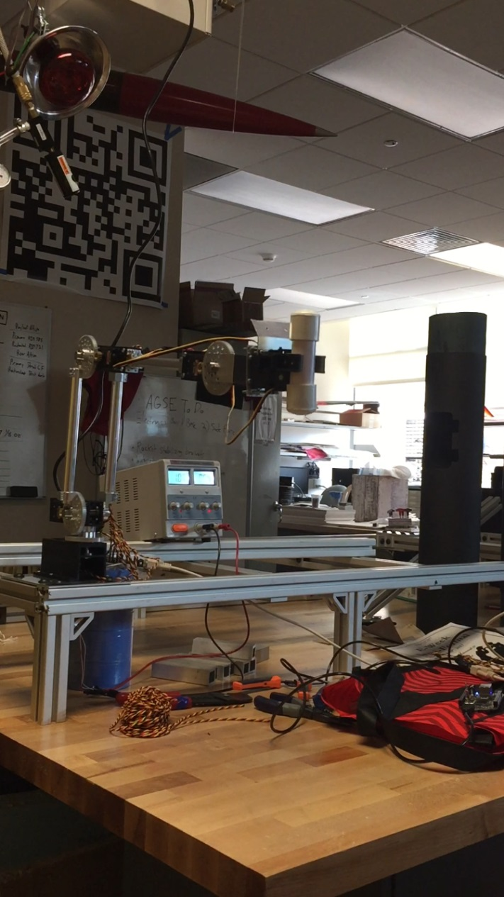
Robotic Arm
4 Degrees of Freedom
5:1 Gear Ratio
252 degrees of rotation at each joint
Able to lift ~1 pound at 24 inches
Uses 11.4 Volt power supply and has up to 10 amp current draw

Slide 27
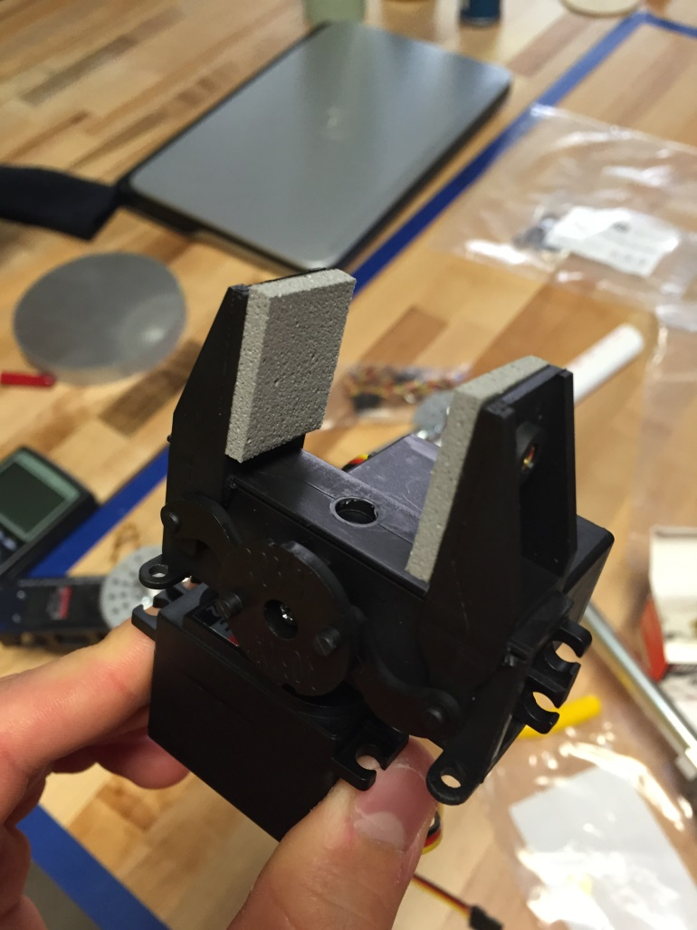
Gripper
Provides 2 additional Degrees of freedom
180 degrees rotation around wrist
Able to open 1.3 inches
Uses up to 6.4 Volt power supply

Slide 28
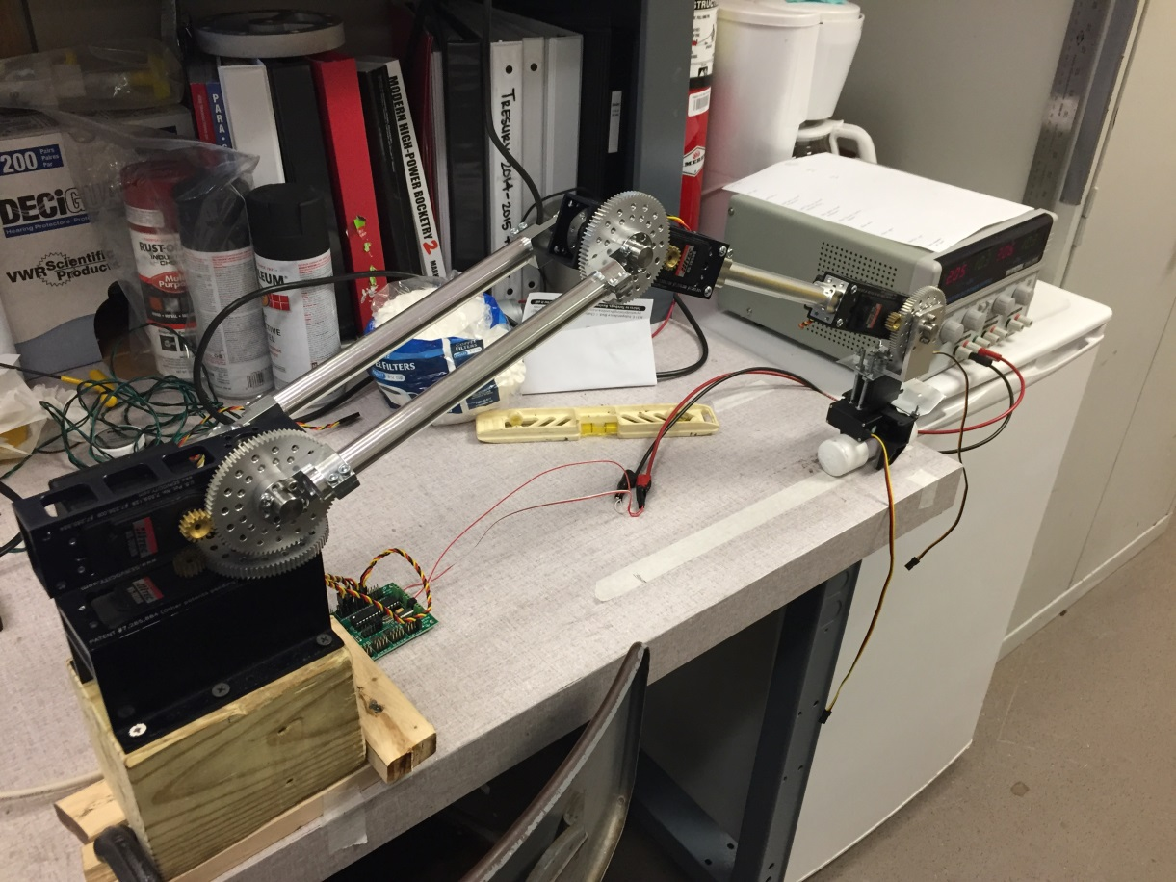
Arm Experiment
4 designated locations
Sample was placed at each location
Arm commanded to move to each location several times
Code used in conjunction with servo utility

Slide 29
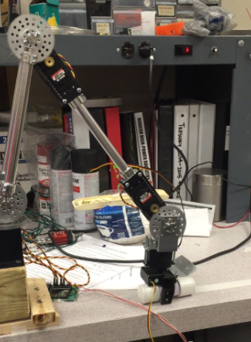
Arm Experiment
Robotic arm grappling payload sample

Slide 30
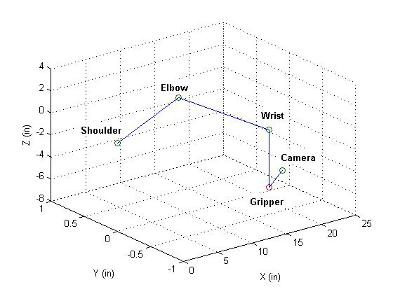
Model of Arm
MATLAB used to plot arm at different servo angles
Code calculates angles in real time

Slide 31
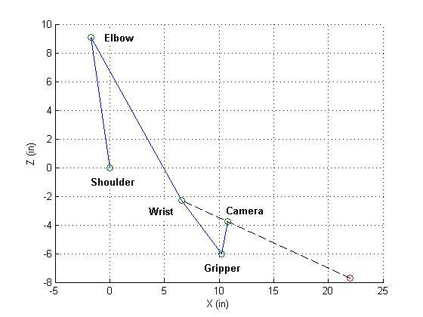
Imaging System Integration
Arm can be commanded to fraction of distance to sample
Code allows camera to point at sample for imaging system

Slide 32
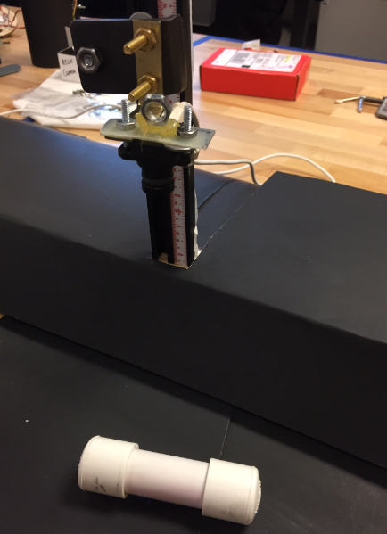
Imaging Experiment
Pictures taken at various heights
Images processed using developed C++ scripts
Curve relates sample image properties to distance between sample and the camera
Yields relation that can be used to find the sample location for a given input image

Slide 33
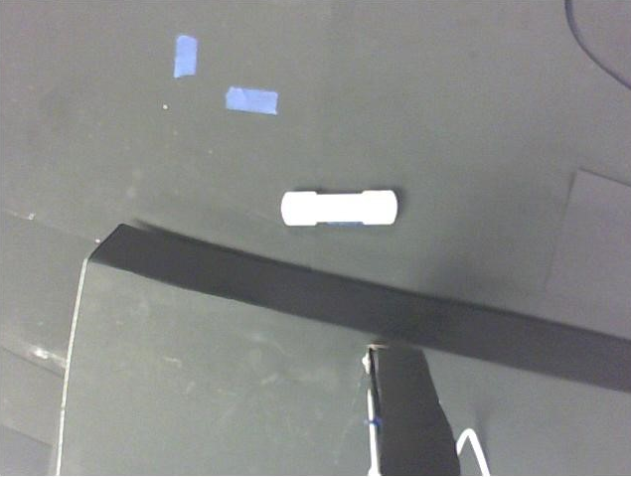
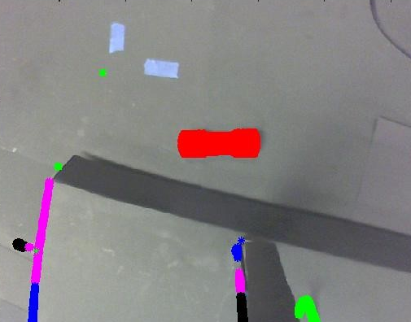
Imaging Experiment
Processed, unfiltered image
Unprocessed, unfiltered image

Slide 34
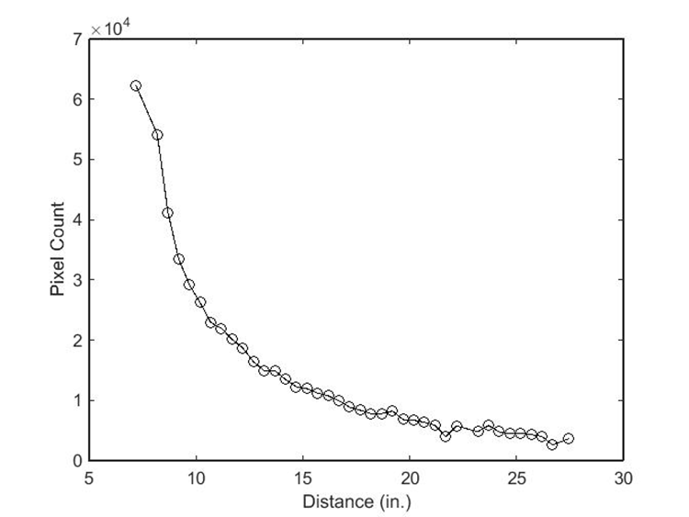
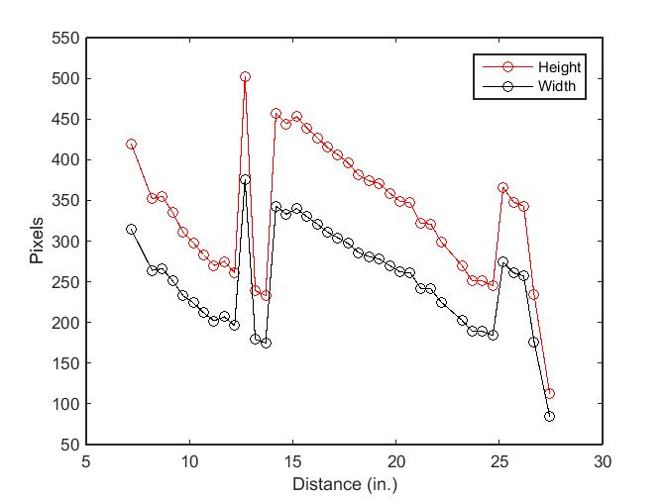
Imaging Experiment
Unfiltered Imaging Experiment Sample Pixel Count vs Distance
Unfiltered Imaging Experiment Sample Dimensions vs Distance

Slide 35
Robotic Arm and Imaging
Chain of Events
  Picture for distance
  Move arm half distance
  Picture for distance
  Move to 4 inches above
  Picture to confirm
  Move arm to sample
  Grapple the cache

Slide 36
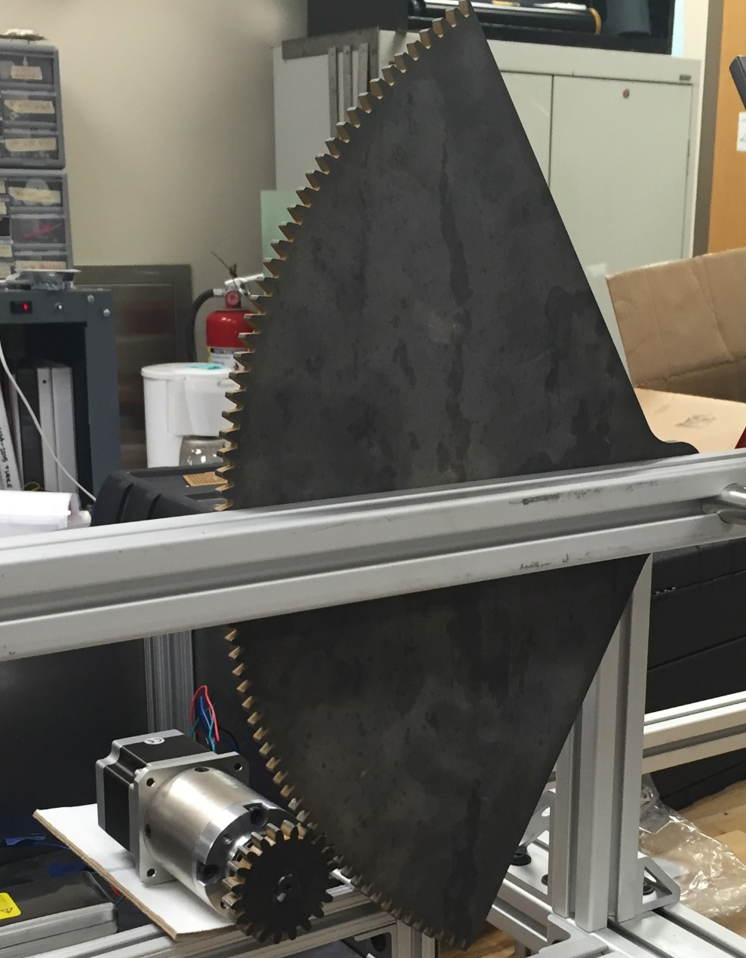
Raising the Rocket
Planetary Gearbox Stepper Motor
  Max Required Torque: 10 ft-lb
Sector Gear
  10 inch pitch radius
  1/4 inch steel
Drive Gear
  1 inch pitch radius
  3/8 inch steel
Rise Time
  Approximately 25 seconds

Slide 37
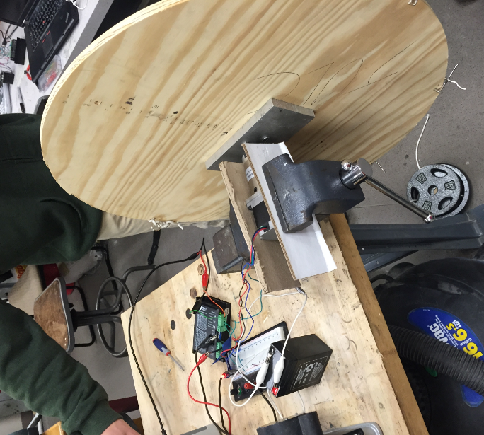
Launch Rail Raising Testing
Setup:
  12 inch radius pulley
  12.5 lb weights hanging radially
  125% of required torque
Results:
  Verified stepper motor capabilities on battery power (37 V)
  Achieved 17.5 ft-lb torque (2000 Hz)
Function Generator Square Wave Frequency (Hz) | 90 Degree Rotation Time (s) | Calculated Launch Rail Rise Time (s)
940 | 5.0 | 47.2
1000 | 4.35 | 41.0
1250 | 3.73 | 35.2
1500 | 3.11 | 29.4
1750 | 2.56 | 24.2
2000 | 2.38 | 22.5

Slide 38
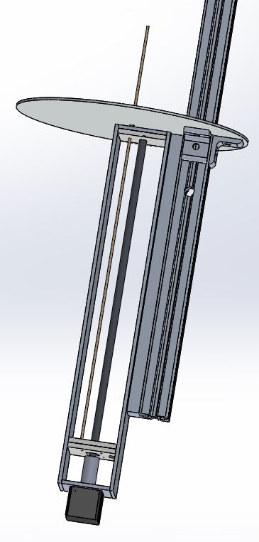
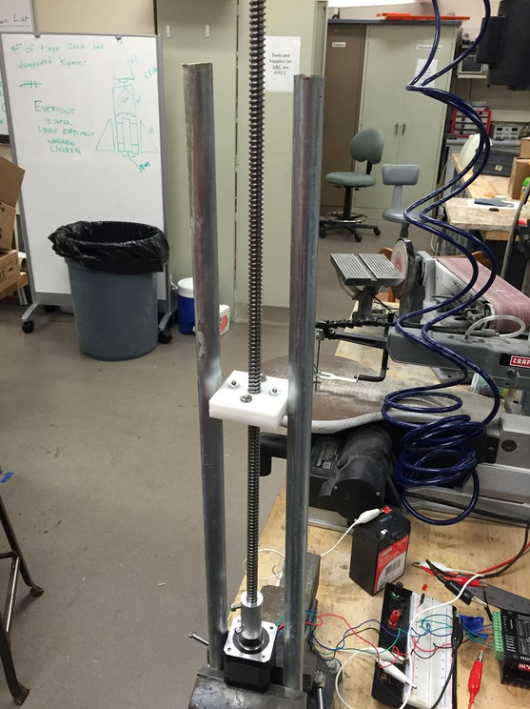
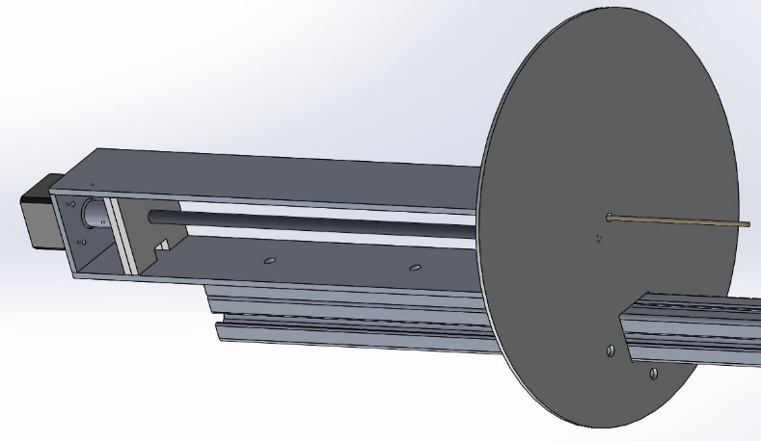
Igniter Insertion
Linear Actuator System Design Aspects:
  Stepper motor rotates threaded rod
  Forward Delrin bearing supports rod
  Threaded Delrin square plate moves vertically due to side plates
  Igniter on dowel moves upward into rocket motor
Insertion Time
  Less than 45 seconds

Slide 39
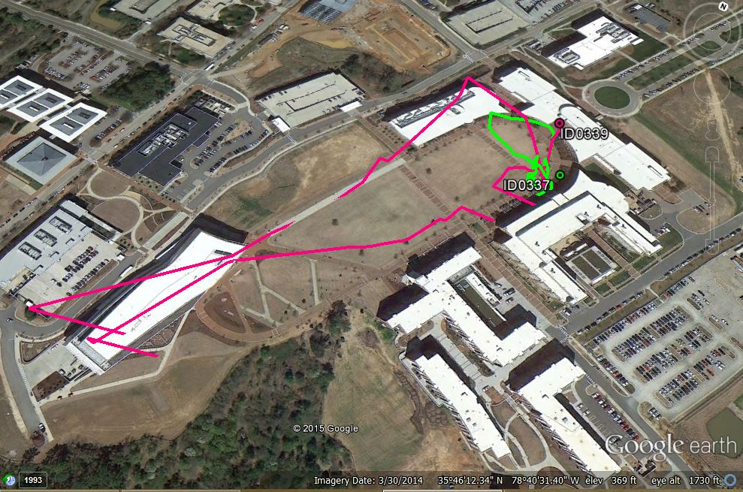
GPS Testing
BRB900 Test

Slide 40
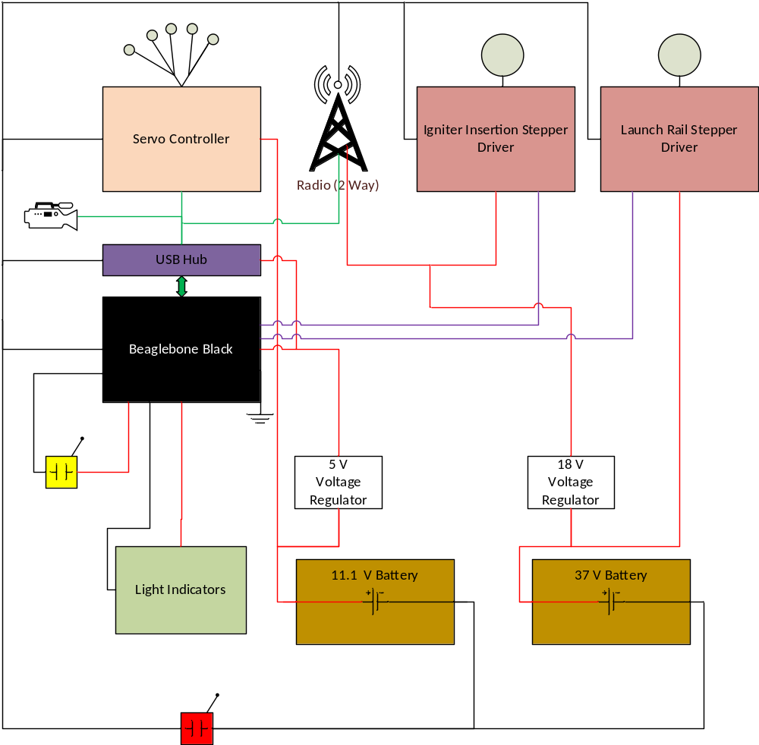
AGSE - Electronics

Slide 41
Requirement Verification
Unverified
Master and Pause Switches
Indicator Lights
AGSE Full System Testing
Making System Fully Autonomous
Integrating the Imaging system with the BeagleBone

Slide 42



Conclusion
Launch Vehicle to Deliver Payload to 3000 ft.
Full Scale Predictions and Results
AGSE Designed to be sturdy, portable, and autonomous
AGSE Subsystem Testing Verify Mission Success

Slide 43
Questions?

