Slide 1

Department of Mechanical and Aerospace Engineering
NASA Student Launch 2014
Preliminary Design Review

Slide 2

Outline
Updates to Full-scale Rocket Design
Subscale
Payload
Experiments
Schedule

Slide 3
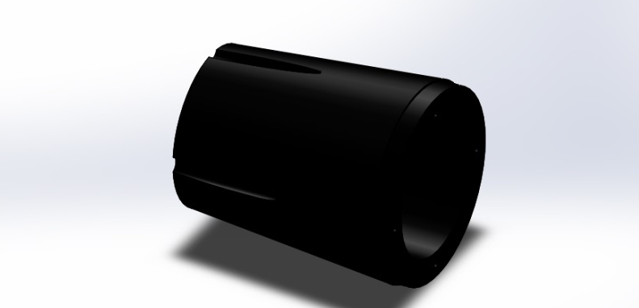
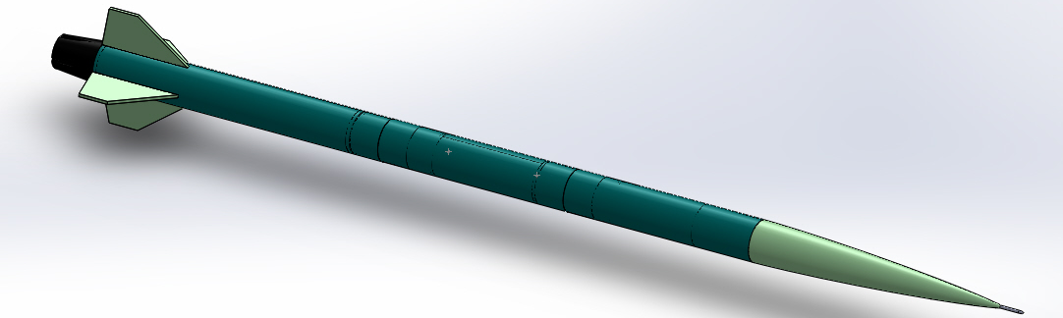
Full-Scale Overview
Overall Dimension
  128 in. x 5.5 in.
Continuous Diameter
Blue Tube w/ Bi-axial FG Sleeve
Boat Tail Base

Slide 4
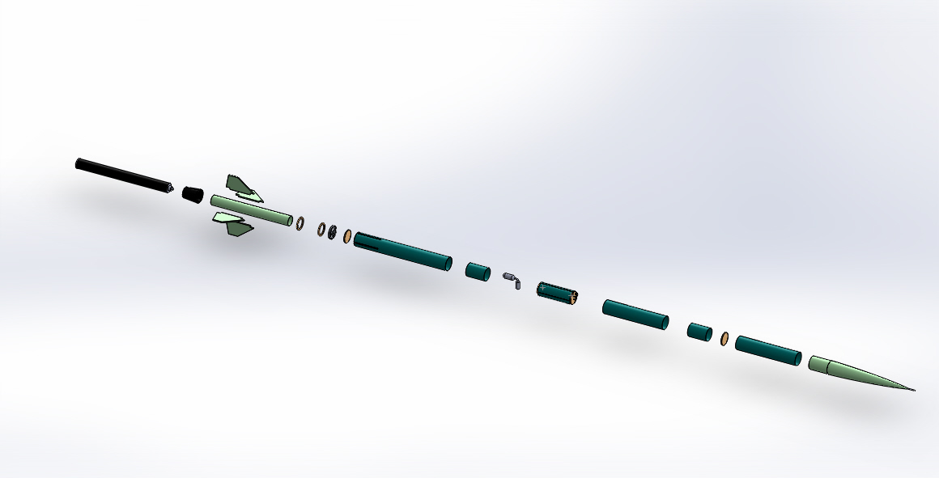
Full-Scale Overview

Slide 5
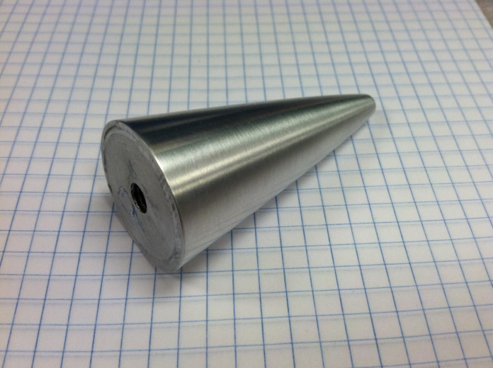
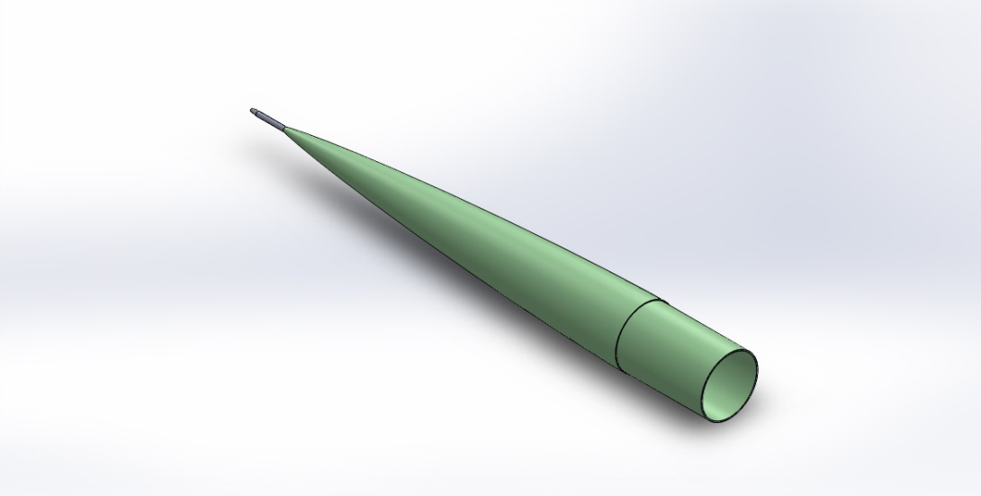
Full-Scale Overview
  Nose Cone
    Ogive 5:1
      Von Karman
      Material
      Dimensions
    History
  Pitot Tube
Notes:
Turned out to be shorter at 30.44 inches
Metal tip for pitot tube, Removable

Slide 6
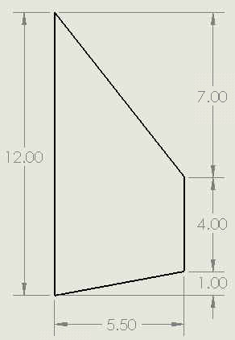
Fins
Number: 4
Root Chord: 12 inches
Tip Chord: 4 inches
Height: 5.5 inches
Sweep Length: 7 inches
Material: 3 ply of 1/16” fiberglass
2 ply of 1/8” birch plywood
Tip to tip fiberglass
Strength: Fin tab will be epoxied to motor
housing. Tip to tip fiberglass will
be used on the motor housing
and the exterior of the body tube.
Notes:
Tip to tip fiberglass under body tube and over body tube for increased strength to reduce chances of fin flutter

Slide 7
Full-Scale Overview
Altimeters
  Entacore AIM 3.0 and PerfectFlite Stratologger SL100
Parachutes: Semi-ellipsoidal w/ deployment bags
  Material: Ripstop Nylon
  Nose Cone
    Diameter: 28 in.
    Descent Rate: ~28.6 ft/s
  Body Tube
    Diameter: 94 in.
    Descent Rate: ~16.1 ft/s
  Fin Section
    Diameter: 160 in.
    Descent Rate: ~12.1 ft/s
Notes:
Using two altimeters: two different manufacturers to account for possible software bugs that could cause two altimeters from same place to both malfunction.
Using third parachute attached to the nose to help pull the deployment bag so the main chute has less chance of failure. Nose cone will be separated from the rest of rocket. Will be connected to the its on small chute and the deployment bag.
A semi-ellipsoidal canopy may employ significantly less fabric than either the hemispherical or parasheet type. This is an important consideration for rockets, where mass and volume must be minimized.

Slide 8
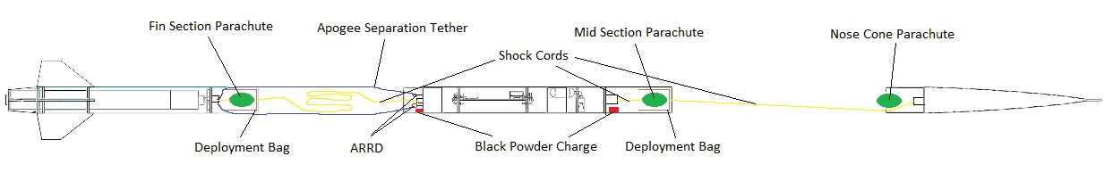
Recovery Configuration

Slide 9
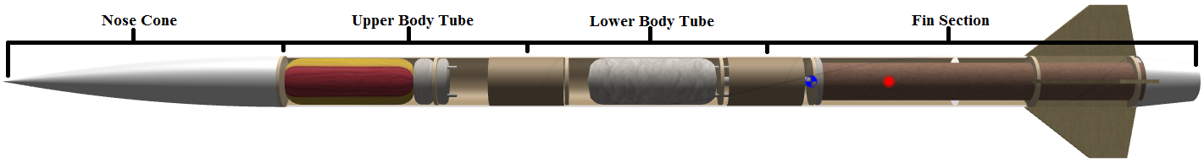
Full-Scale Overview
Rocket will be 4 sections
Nose Cone: 30.44” Upper Body Tube: 26.0” Lower Body Tube: 26.0” Fin Can w/ Boat Tail: 45.5”
Access to payload and avionics will be screwed together prior to launch.
Notes:
Access to payload and avionics will be screwed together prior to launch.

Slide 10
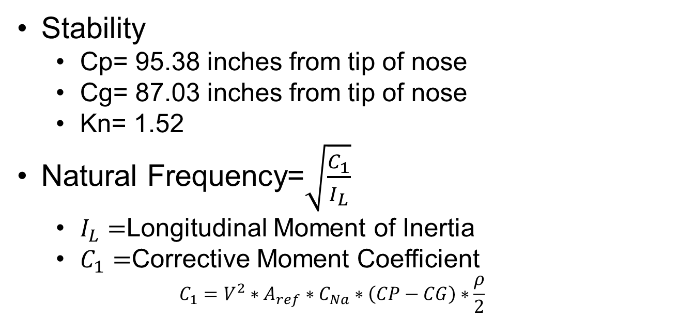
Full-Scale Overview
Stability
  Cp= 95.38 inches from tip of nose
  Cg= 87.03 inches from tip of nose
  Kn= 1.52
Natural Frequency=$\sqrt{\frac{C_{1}}{I_{L}}}$
  $I_{L}=$Longitudinal Moment of Inertia
  $C_{1}=$Corrective Moment Coefficient
  $$C_{1}=V^{2}∗A_{ref}∗C_{Na}∗\left(CP−CG\right)∗\frac{ρ}{2}$$
Notes:
Max Natural Frequency= 37.8 rad/s occurs just prior to motor burnout. Will use this number to determine sample rate. (10*Wn=sample rate)
Inertia is calculated from OpenRocket. C1 has to be calculated but uses numbers from OpenRocket.
Website Reference to equations. http://openrocket.trans.free.fr/index.php?option=com_content&view=article&id=18&Itemid=15&lang=en

Slide 11
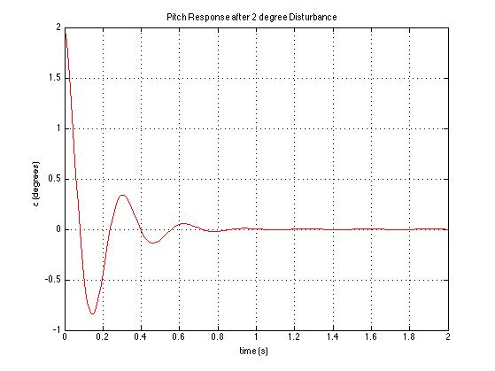
Stability
Aerodynamic center: 95.38 in aft of datum
CG: 87.03 in aft of datum
K_{n} = 1.52 calibre
Natural Frequency: 37.8 rad/s (6.02 Hz)
Damping ratio: 0.20
Time to half: 0.09 s

Slide 12
Vehicle Data
Weight w/ Motor: 69.0 lb
Apogee: 13900 ft
Max Velocity: 1385 ft/s
Max Mach #: 1.25
Supersonic Period: 2.45 s
Max Accel: 678 ft/s^2
T/W Ratio: 23
Rail Exit Velocity: 102 ft/s

Slide 13
Motor Selection
Brand: Cesaroni Technology Inc.
Model: N5600WT-P
Total Impulse: 3065 lbf*s
Avg Thrust: 1264 lbf
Max Thrust: 1517 lbf
Burn Time: 2.42 s
Propellant Weight: 14.1 lb

Slide 14
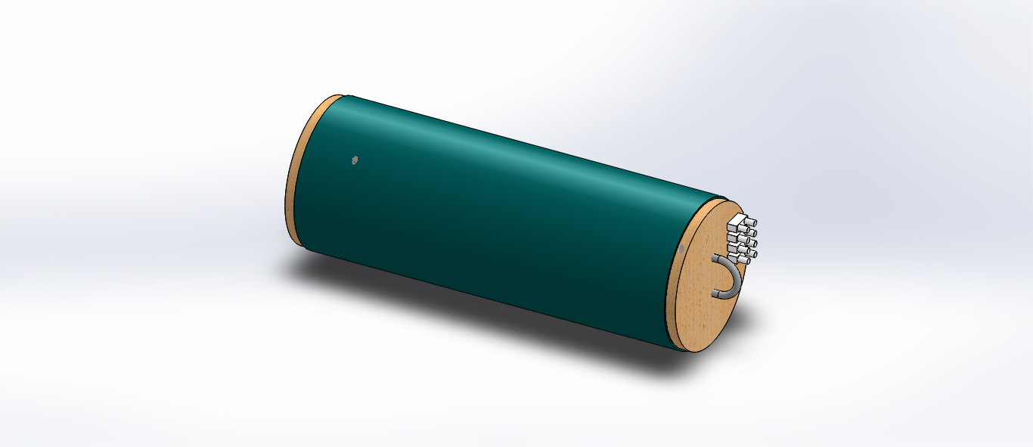
Full-Scale Overview
Payload Bay
  Dimensions
  Components
  History
Notes:
Discuss components in detail, ie what each does manuf item number etc

Slide 15
Sub-Scale Overview
Scaling Factor: 1:2.149
  59.56 in. x 2.56 in. Dia
  Weight: 4.23 lbs (Dry Weight)
  Identical Construction Techniques
  Stability
  Dual Deploy
Notes:
sub-scale will be used to prove that the full scale is stable. Will use the same static margin that the full scale has.
sub-scale will be used to prove recovery system for full scale. Will have two altimeters with a drogue and main parachute.

Slide 16
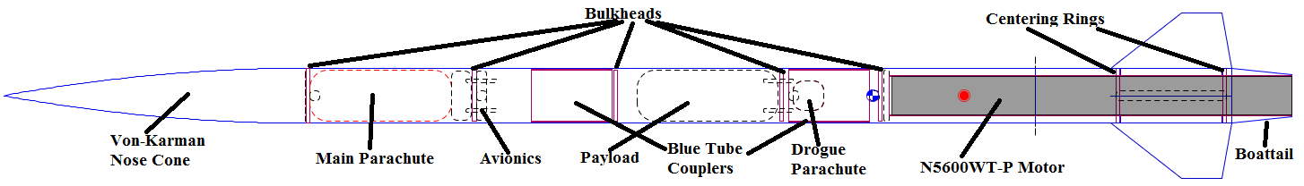
Payload: General Layout
Payload positioned in close proximity to
CG location
  Negligible change in static margin with change of payload weight.

Slide 17
Payload Overview
Experiment Requirements
Components to be used
  Data to be recorded
  Resolution of Data
Value of Data to be Collected
Notes:
Discuss components in detail, ie what each does manuf item number etc

Slide 18
Hazard Detection System
Equipment
Activation
Hazard Detection Algorithm
  Specification of Hazard

Slide 19
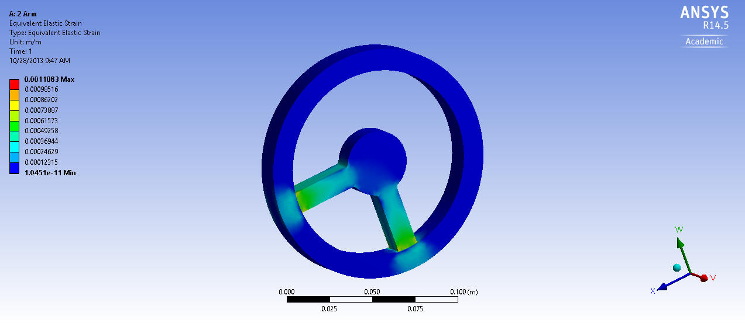
Load Cell
Design and Analysis
Motor Performance
Thrust derivation
Published Value
Comparison

Slide 20
Payload: Onboard Processing
Core Processor (Options)
  Raspberry Pi: Model B version 2.0 512MB
    700 MHz
    Linux Based
  Arduino Due
    84 MHz
    Arduino based
  Arduino Mega 2560
    25 MHz
    Arduino Based
Notes:
Mention trade offs between all three processors ie
Raspberry – Faster yet more difficult to interface if no Kernal exists, needs raspberry pi to arduino sheld interface board
Arduino Due – New and middle speed but few Analog I/O’s
Arduino Mega – Slowest But most Analog I/O’s at 16
Also mention serial port availability for GPS and IMU

Slide 21
Experiment Overview
High Power Rocket Dynamics Model and Analysis
  Create a dynamic model for a high power rocket
  Goal is to determine dynamic modes and quantify disturbance to flightpath caused by thruster firing
  MATLAB/SIMULINK

Slide 22
Experiment Overview
Black Powder Charge Sizing
  Determine the appropriate size of the black powder charges used to deploy parachutes
  Initial charge size determined using online calculator
  Charge size adjusted based off experimental ejection tests

Slide 23
Experiment Overview
Determining Blue Tube Material Properties
  Experimentally determine the material properties (Poisson’s ratio, ultimate strength)
  Instrom machine used to apply loads
  Strain gages recorded material response
  Material properties to be used in subsequent stress analysis

Slide 24
Experiment Overview
Aerodynamics
  Use FLUENT to analyze rocket performance
  Multiple angles of attack run
  Aerodynamic coefficients determined (MATLAB): C_{L}, C_{D}, C_{Mα}, C_{Di}, C_{Do}, C_{Lα}, L, D, CP, K_{N}

Slide 25
Experiment Overview
Propulsion
  Determine amount of force exerted by thruster
  Mounted to engine test stand, thrust recorded with varying gas pressures
  Curve of pressure vs. thrust created, used to determine the amount of pressure required to achieve desired disturbance

Slide 26
Schedule
1/16/14 Subscale Ejection testing
1/18/14 Subscale Launch at Bayboro, NC
1/20/-Until Perform Experiments
2/1/14 Begin Construction
1/25/14 Astronomy Days Outreach Event
3/2/14 YMCA Outreach Event
4/19/14 Boy Scout Outreach Event

Slide 27
Questions?
“Scientists investigate that which already is;
Engineers create that which has never been.”
-Albert Einstein

